Slide 1
MILK
FREE TEMPLATE
Here is where your presentation begins

Slide 2
BREAK TIME

Slide 3
CONTENTS OF THIS TEMPLATE
Content Here
Content Here
You can simply impress your audience and add a unique zing and appeal to your Presentations.
You can simply impress your audience and add a unique zing and appeal to your Presentations.
Content Here
Content Here
You can simply impress your audience and add a unique zing and appeal to your Presentations.
You can simply impress your audience and add a unique zing and appeal to your Presentations.

Slide 4
SPLASH!
This could be the part of the presentation where you can introduce yourself, write your email…

Slide 5
TABLE OF CONTENTS
01
02
03
ABOUT THIS DAY
KEY METRICS
CONCLUSION
You could describe the topic of the section here
You could describe the topic of the section here
You could describe the topic of the section here

Slide 6
Images & Contents
Contents Title
Contents Title
You can simply impress your audience and add a unique zing and appeal to your Presentations. Easy to change colors, photos and Text.
You can simply impress your audience and add a unique zing and appeal to your Presentations. Easy to change colors, photos and Text.
Contents Title
Contents Title
You can simply impress your audience and add a unique zing and appeal to your Presentations. Easy to change colors, photos and Text.
You can simply impress your audience and add a unique zing and appeal to your Presentations. Easy to change colors, photos and Text.

Slide 7
—SOMEONE FAMOUS
“This is a quote, words full of wisdom that someone important said and can make the reader get inspired”

Slide 8
ABOUT THIS DAY
01
You could enter a subtitle here in case you need it

Slide 9
WHY SHOULD YOU DRINK MILK?
Do you know what helps you make your point clear? Lists like this one:
They’re simple
You can organize your ideas clearly
You’ll never forget to buy milk!
And the most important thing: the audience won’t miss the point of your presentation if you use them

Slide 10
MAYBE YOU NEED TWO COLUMNS
MERCURY
VENUS
It is the closest planet to the Sun and the smallest one in the Solar System—it’s only a bit larger than the Moon
Venus has a beautiful name and is the second planet from the Sun. It’s hot and has a poisonous atmosphere

Slide 11
THE FUNCTIONS OF CALCIUM
MERCURY
VENUS
MARS
It’s the closest planet to the Sun and the smallest in the Solar System
Venus has a beautiful name and is the second planet from the Sun
Despite being red, Mars is actually a cold place. It’s full of iron oxide dust

Slide 12
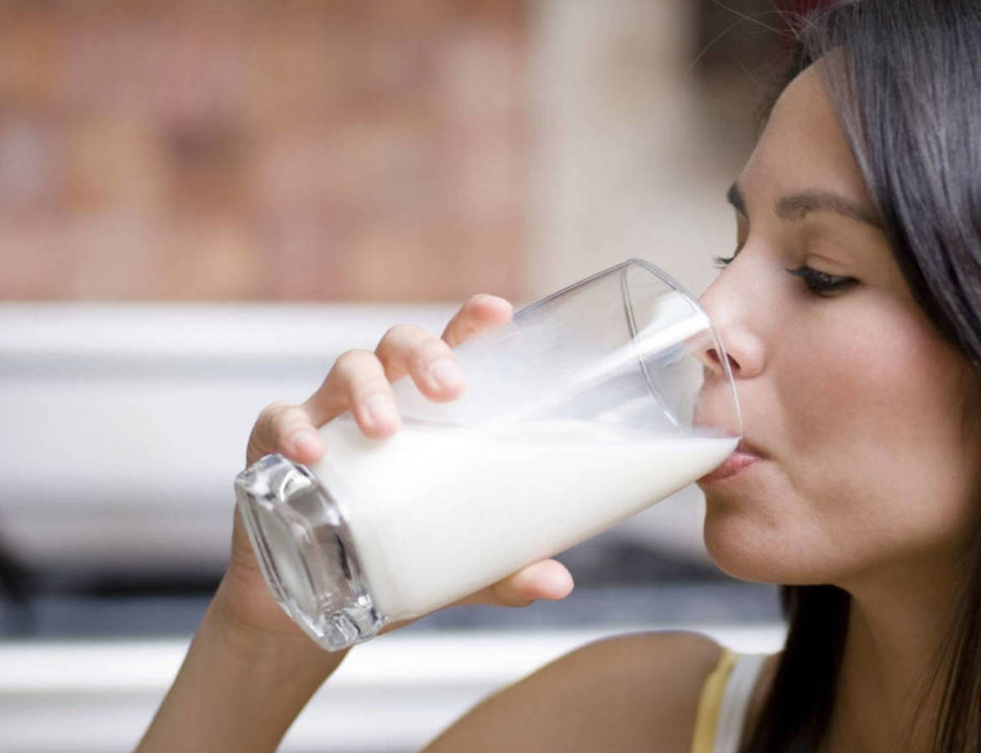
A PICTURE ALWAYS REINFORCES THE CONCEPT
Images reveal large amounts of data, so remember: use an image instead of a long text. Your audience will appreciate it

Slide 13
AWESOME DRINK

Slide 14
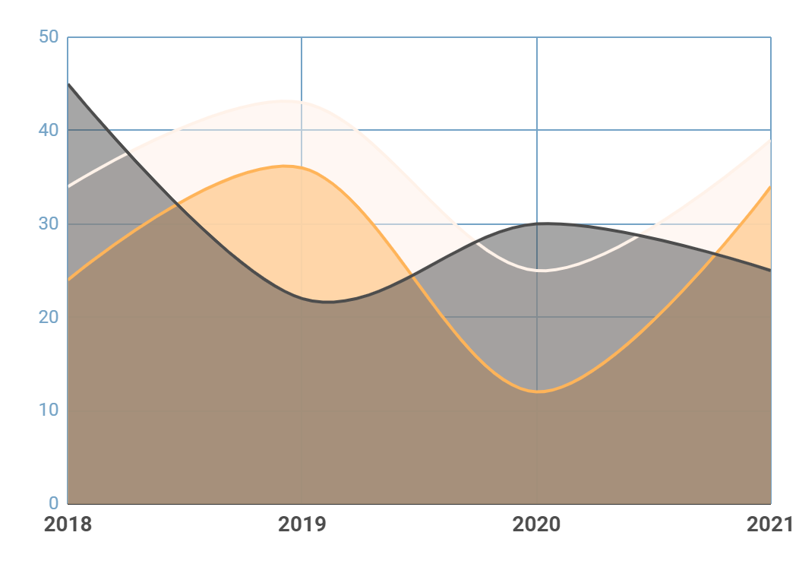
THIS IS A GRAPH
MERCURY
20%
Mercury is the closest planet to the Sun
MARS
40%
Despite being red, Mars is actually a cold place
SATURN
60%
Saturn is composed of hydrogen and helium
Follow the link in the graph to modify its data and then paste the new one here. For more info, click here

Slide 15
6 PROVEN HEALTH BENEFITS OF MILK
MERCURY
VENUS
MARS
JUPITER
SATURN
NEPTUNE
Mercury is the closest planet to the Sun
Venus has a beautiful name, but it is hot
Despite being red, Mars is a very cold place
Jupiter is the biggest planet of them all
Yes, Saturn is the ringed planet and a gas giant
Neptune is the farthest planet from the Sun

Slide 16
02
KEY METRICS
You could enter a subtitle here in case you need it

Slide 17
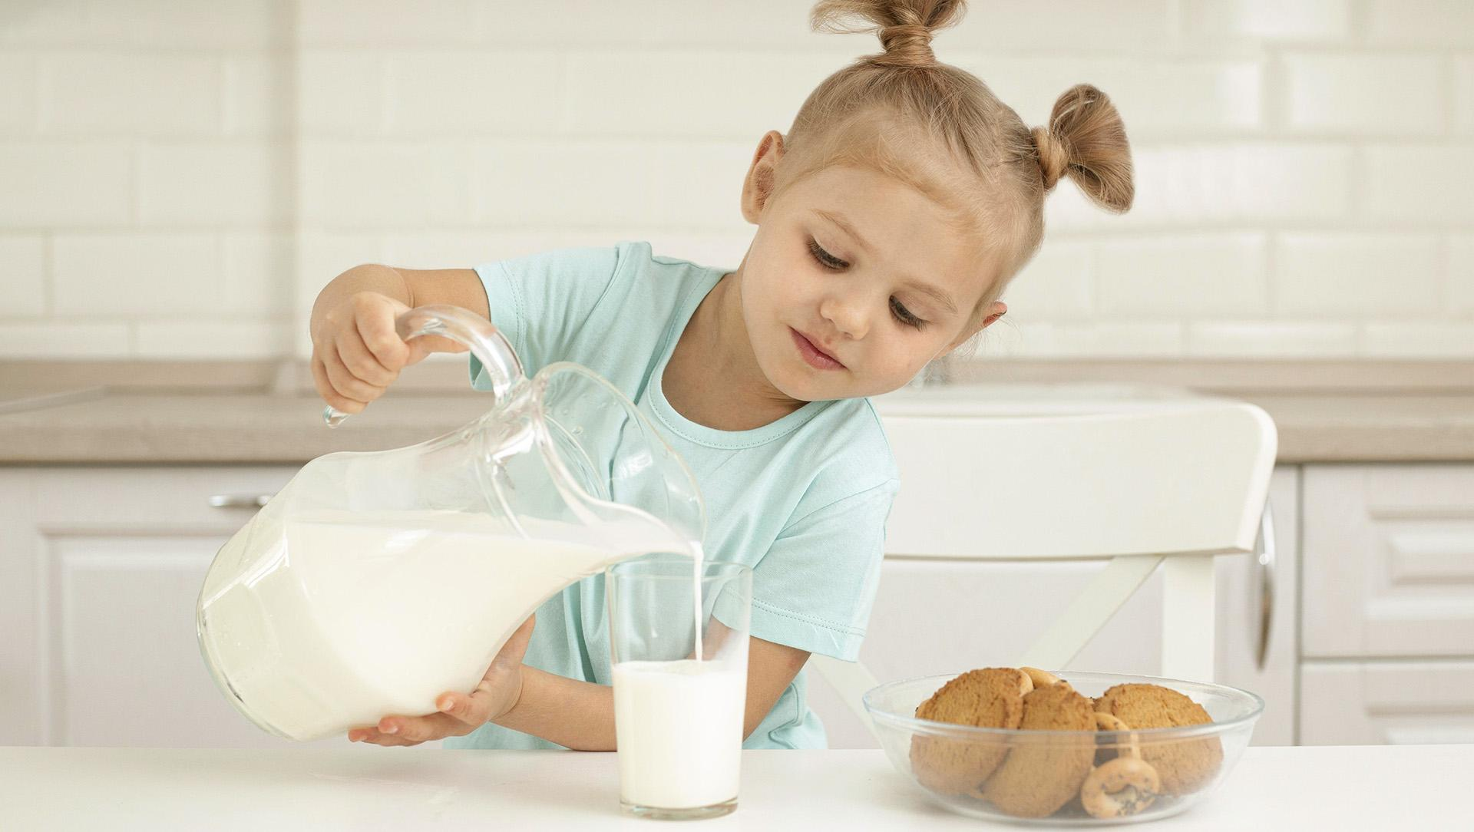
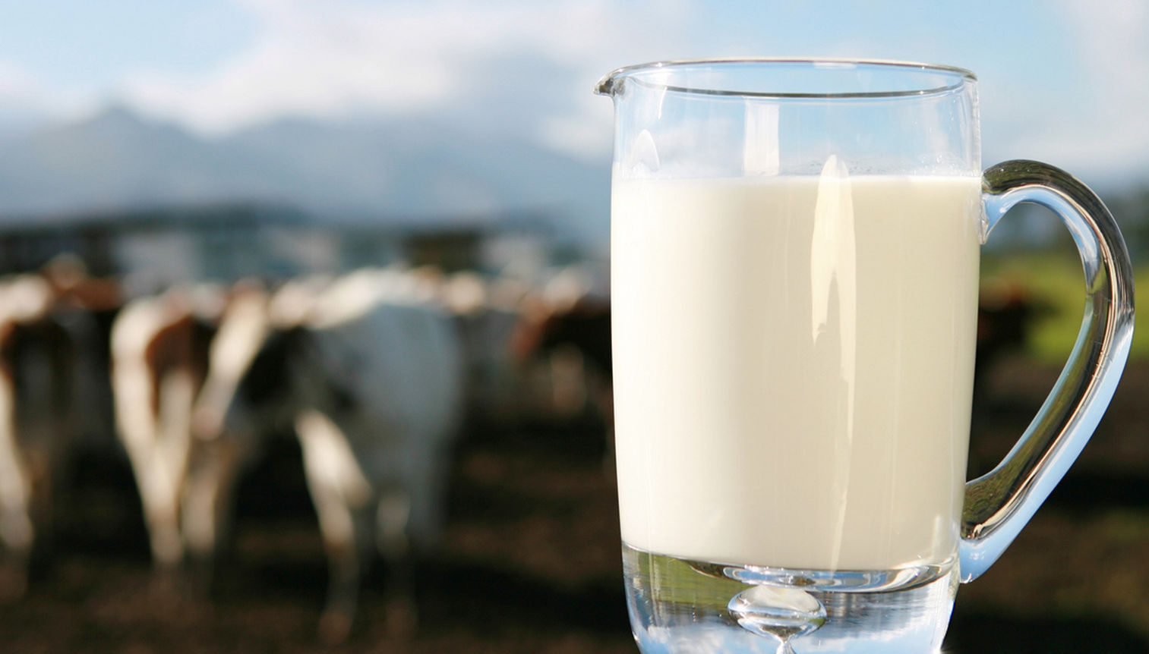
A PICTURE IS WORTH A THOUSAND WORDS

Slide 18
TRY USING AN INFOGRAPHIC
NEPTUNE
SATURN
Neptune is the farthest planet
Saturn has rings and it’s a gas giant
SATURN
NEPTUNE
Jupiter is the biggest planet
Venus has a beautiful name
JUPITER
VENUS

Slide 19
CHARACTERISTIC OF MILK TYPES
Example Text : Get a modern PowerPoint Presentation that is beautifully designed. I believe that this Template will your Time.
1
Example Text : Get a modern PowerPoint Presentation that is beautifully designed. I believe that this Template will your Time.
2
Example Text : Get a modern PowerPoint Presentation that is beautifully designed. I believe that this Template will your Time.
3
Example Text : Get a modern PowerPoint Presentation that is beautifully designed. I believe that this Template will your Time.
4

Slide 20
CHARACTERISTIC OF MILK TYPES
 | WHOLE | SKIMMED | ORGANIC | FLAVORED
It is the closest planet to the Sun
It is smallest planet in the Solar System
It’s the biggest planet of them all
Venus has a beautiful name

Slide 21
TYPES OF MILK
WHOLE
SKIMMED
ORGANIC
FLAVORED
Mercury is the smallest planet in the Solar System
It is the second planet from the Sun and has a beautiful name
Yes, Saturn is the ringed planet and a gas giant as well
Jupiter is the biggest planet of them all and a gas giant

Slide 22
350,000
Big numbers catch your audience’s attention

Slide 23
24h 37m 23s
333,000.000
386,000 km
Earths is the Sun’s mass
It’s Jupiter's rotation period
It’s the distance between Earth and the Moon

Slide 24
THIS IS A MAP
Mercury is the closest planet to the Sun and the smallest one in the Solar System—it’s only a bit larger than the Moon
MARS
SATURN

Slide 25
KEY METRICS
1. Contents Here A
You can simply impress your audience and add a unique zing and appeal to your Presentations. Easy to change colors, photos and Text.
2. Contents Here B
You can simply impress your audience and add a unique zing and appeal to your Presentations. Easy to change colors, photos and Text.
3. Contents Here C
You can simply impress your audience and add a unique zing and appeal to your Presentations. Easy to change colors, photos and Text.

Slide 26
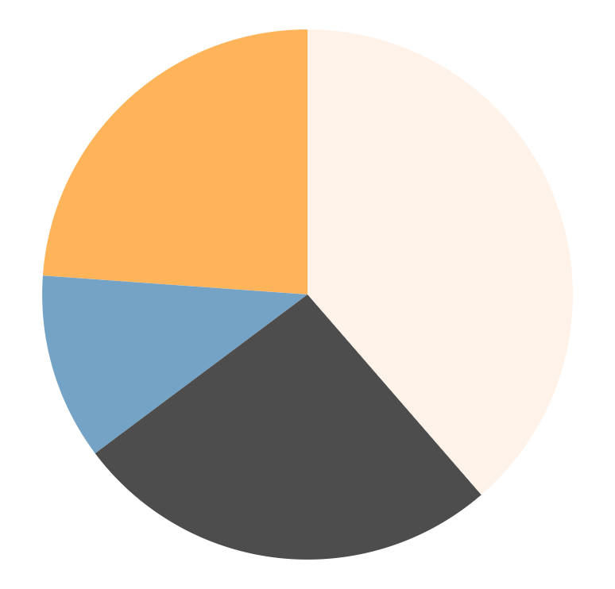
KEY METRICS
VENUS
MERCURY
25%
Venus is the second planet from the Sun
Mercury is the closest planet to the Sun
40%
10%
MARS
JUPITER
25%
Despite being red, Mars is actually a cold place
It’s the biggest planet in the Solar System
Follow the link in the graph to modify its data and then paste the new one here. For more info, click here

Slide 27
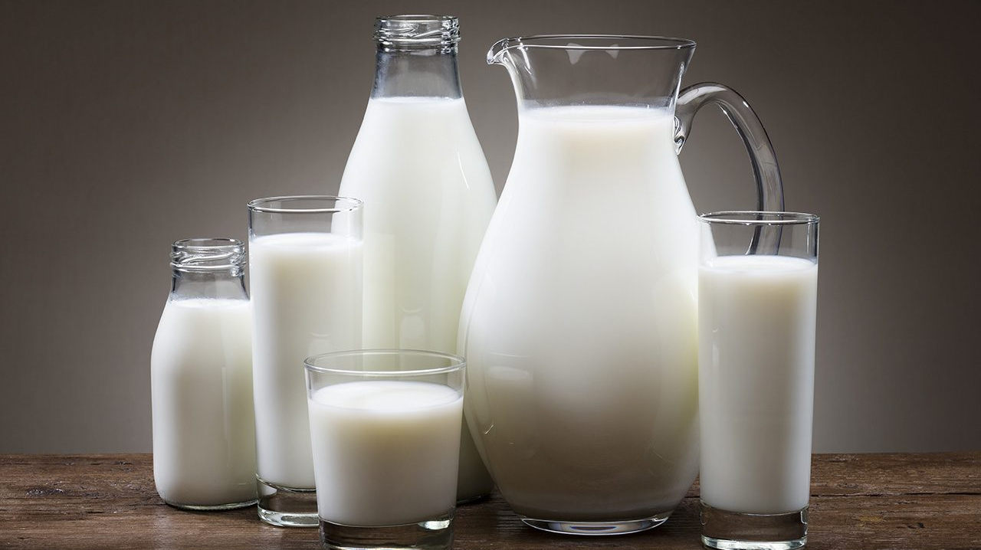
THIS IS A MAP
Mercury is the closest planet to the Sun and the smallest one in the Solar System—it’s only a bit larger than the Moon
Mercury is the closest planet to the Sun and the smallest one in the Solar System—it’s only a bit larger than the Moon

Slide 28
A TIMELINE ALWAYS WORKS FINE
1 STEP
2 STEP
3 STEP
4 STEP
Venus is the second planet from the Sun
Mercury is the smallest planet in the Solar System
Mars is actually a cold place full of iron oxide dust
Jupiter is the biggest planet in the Solar System

Slide 29
03
MAIN CONCLUSION
You could enter a subtitle here in case you need it

Slide 30
DO YOU NEED PERCENTAGES?
60%
80%
50%
Despite being red, Mars is a cold place
Neptune is the farthest planet from the Sun
Mercury is the closest planet to the Sun

Slide 31
ABOUT THE PRODUCT
JUPITER
Jupiter is the biggest planet
SATURN
Saturn is a gas giant a has rings
MARS
Despite being red, Mars is a cold place
VENUS
Venus has beautiful name, but it’s hot

Slide 32
THIS IS A TABLE
 | WEEK1 | WEEK 2 | WEEK 3
SEBASTIAN | 100 ml | 355 ml | 370 ml
SAUL | 490 ml | 150 ml | 890 ml
EMMA | 1,000 ml | 260 ml | 245 ml

Slide 33
EDITIONS OF THE EVENT
2018
2020
It’s the farthest planet from the Sun
Venus has a beautiful name
1st
3rd
5th
2nd
4th
2017
2019
2021
Despite being red, Mars is a cold place
It’s the ringed planet and a gas giant
Earth is the planet we all live on

Slide 34
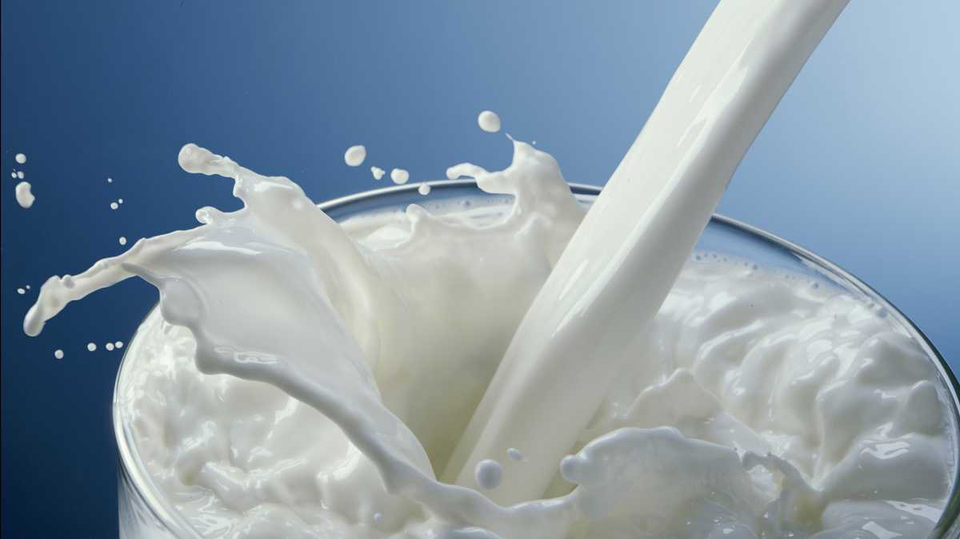
DESKTOP SOFTWARE
You can replace the image on the screen with your own work. Just right-click on it and select “Replace image”
You can replace the image on the screen with your own work. Just right-click on it and select “Replace image”
You can replace the image on the screen with your own work. Just right-click on it and select “Replace image”
You can replace the image on the screen with your own work. Just right-click on it and select “Replace image”
You can replace the image on the screen with your own work. Just right-click on it and select “Replace image”
You can replace the image on the screen with your own work. Just right-click on it and select “Replace image”

Slide 35
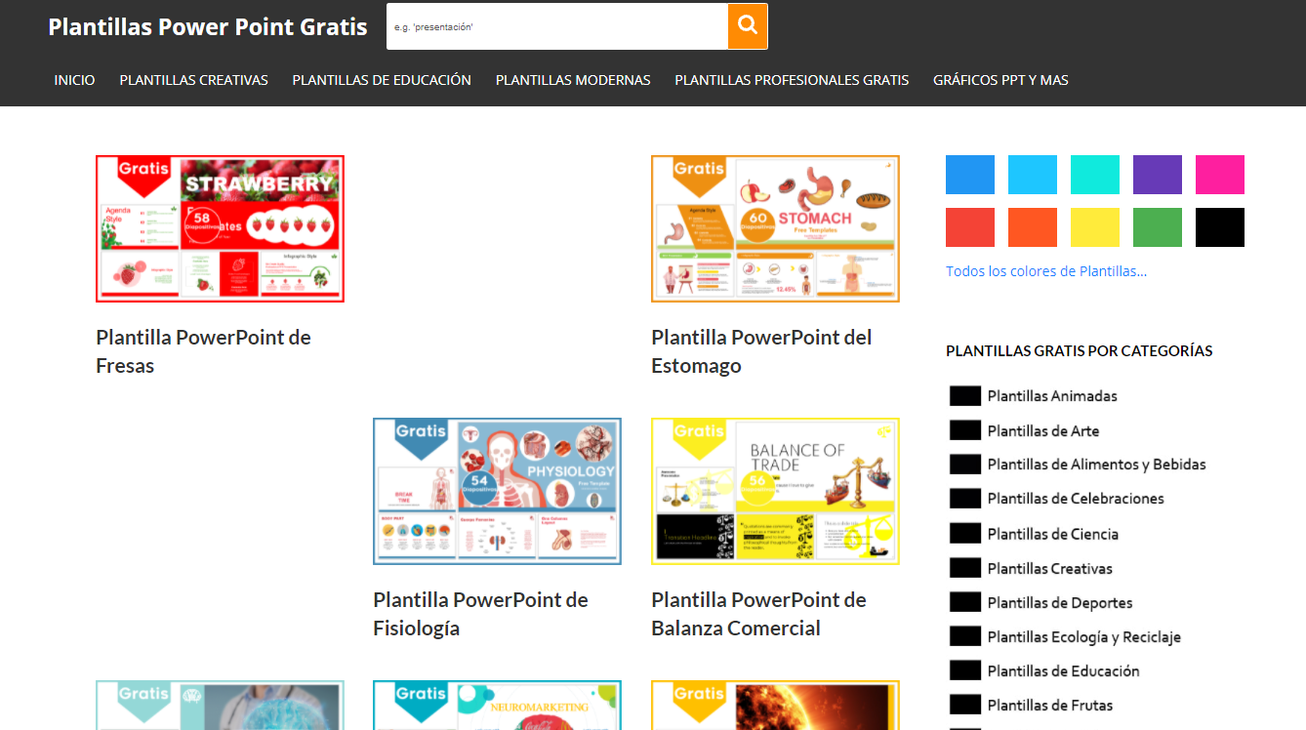
DESKTOP SOFTWARE
You can replace the image on the screen with your own work. Just right-click on it and select “Replace image”

Slide 36
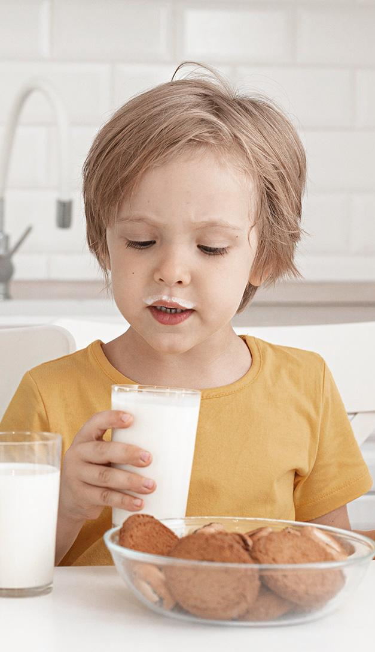
MOBILE WEB
You can replace the image on the screen with your own work. Just right-click on it and select “Replace image”
You can replace the image on the screen with your own work. Just right-click on it and select “Replace image”

Slide 37
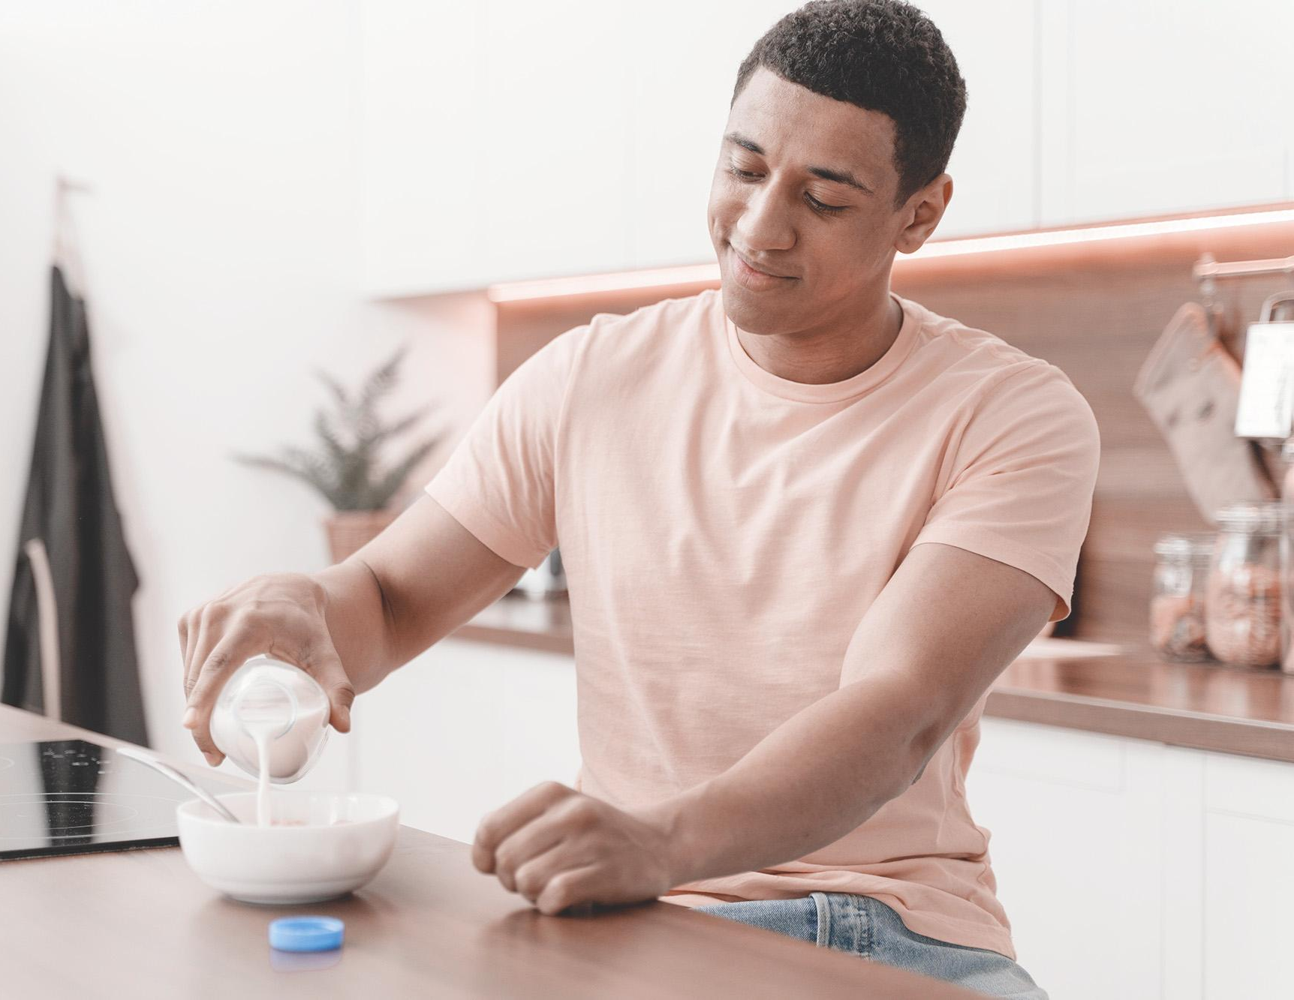
TABLET APP
You can replace the image on the screen with your own work. Just right-click on it and select “Replace image”

Slide 38
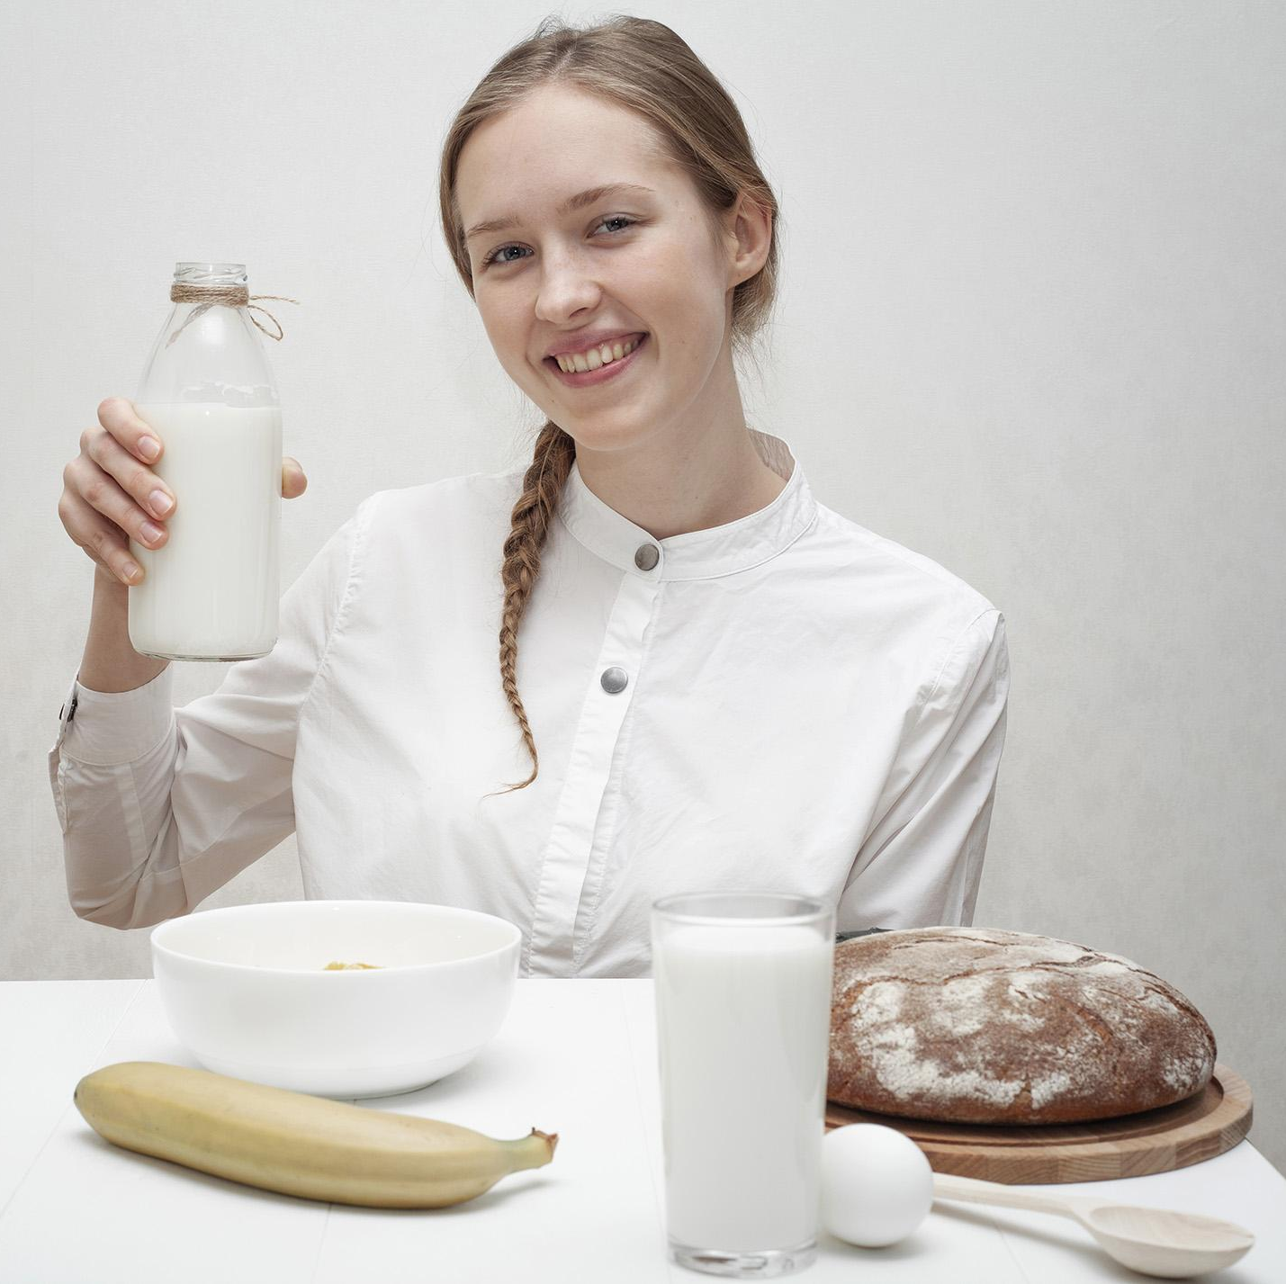
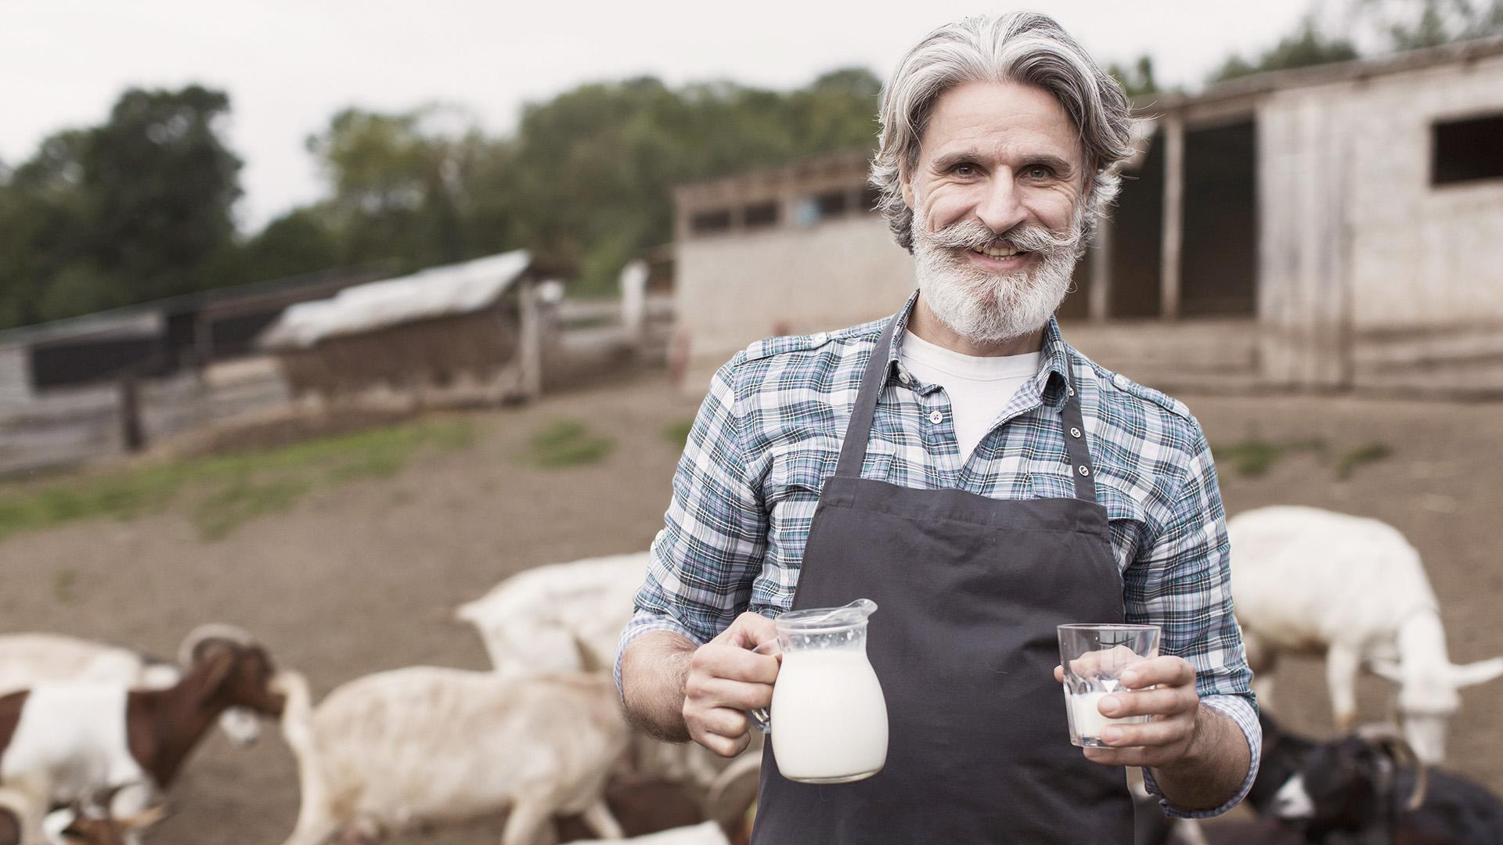
OUR TEAM
CARRIE SMITH
JOHN DOE
Here you can talk a bit about this person
Here you can talk a bit about this person

Slide 39
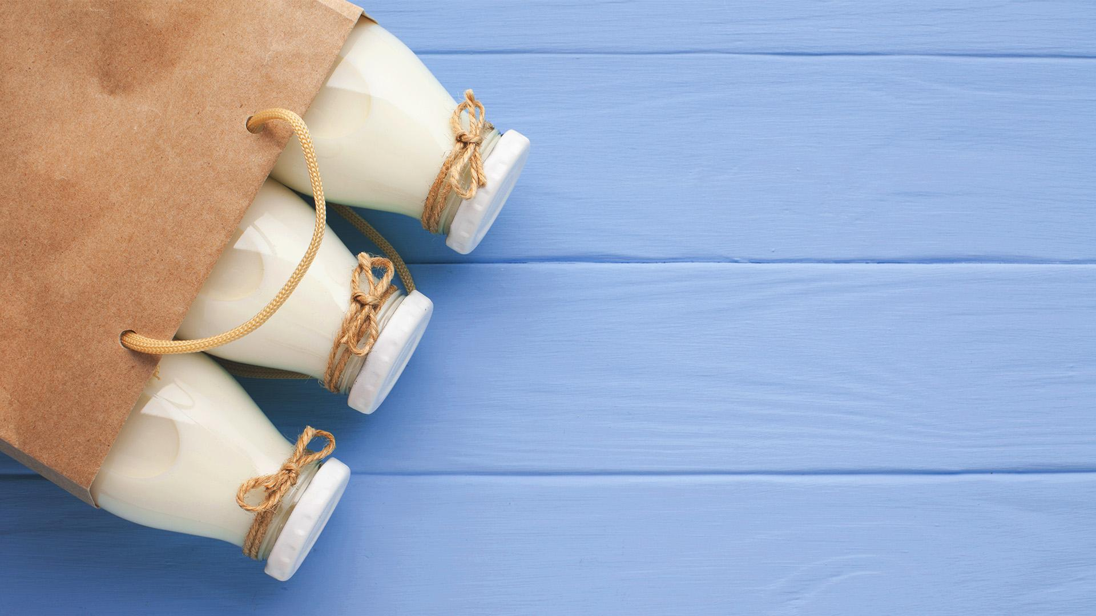
CONCLUSIONS
Mercury is the closest planet to the Sun and the smallest one in the Solar System—it’s only a bit larger than the Moon
Mercury is the god of commerce, messenger of the gods, mediator between gods and mortals

Slide 40
DALGONA COFFEE RECIPE
2sp COFFEE 3sp SUGAR
2 CUPS OF WATER
MIX INGREDIENTS
1
2
3
MILK AND ICE CUBES
DALGONA COFFEE
4
5

Slide 41
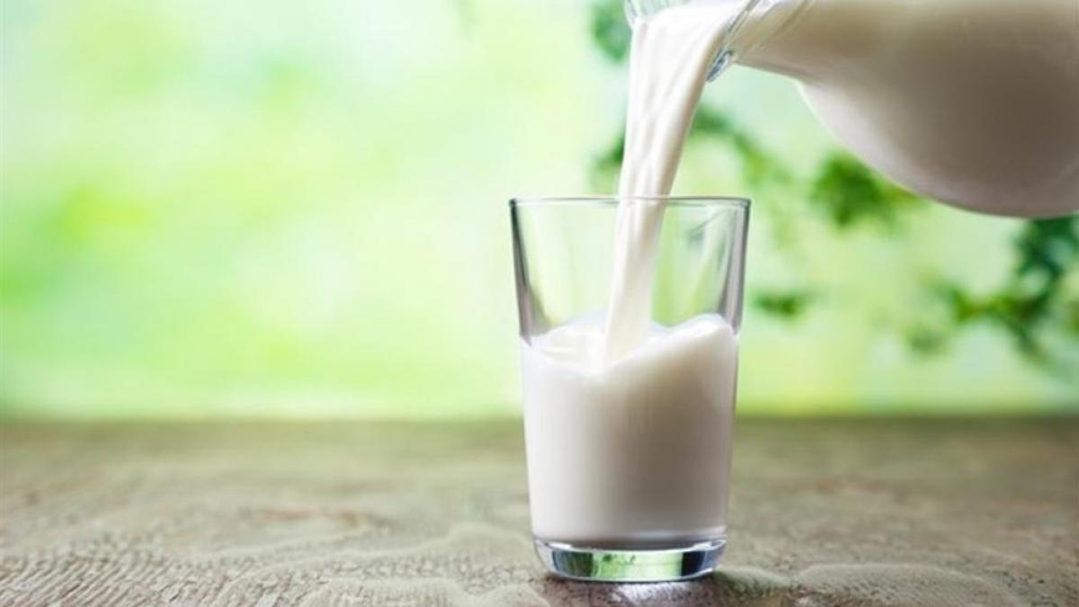
ALLPPT Layout
Clean Text Slide for your Presentation
You can simply impress your audience and add a unique zing and appeal to your Presentations. Get a modern PowerPoint Presentation that is beautifully designed. I hope and I believe that this Template will your Time, Money and Reputation. Easy to change colors, photos and Text. Get a modern PowerPoint Presentation that is beautifully designed.
INFOGRAPHIC

Slide 42
THANKS!
Do you have any questions?
Mercury is the god of commerce, messenger of the gods, mediator between gods and mortals

Slide 43
www.plantillaspower-point.com

Slide 44
ALTERNATIVE RESOURCES

Slide 45
ALTERNATIVE RESOURCES

Slide 46
ALTERNATIVE RESOURCES

Slide 47
ALTERNATIVE RESOURCES

Slide 50
JANUARY
FEBRUARY
MARCH
APRIL
MAY
JUNE
PHASE 1
Task 1
Task 2
PHASE 2
Task 1
Task 2
JANUARY
FEBRUARY
MARCH
APRIL
PHASE 1
Task 1
Task 2

