Slide 1
CRAFTS
Free Template

Slide 2
Contents of this template
If you’re going to show your project to your classmates, a dynamic and funny approach could be better.

Slide 3
Whoa!
Learn how to give a good presentation in PowerPoint or Google Slides

Slide 4
“Know your audience and adapt the presentation to them. Try to use the appropriate tone for each occasion.”
—SOMEONE FAMOUS

Slide 5
Tips
Text
Text
Text
It must be legible at a glance, so try to use big font sizes
It must be legible at a glance, so try to use big font sizes
It must be legible at a glance, so try to use big font sizes

Slide 6
Choose the tone
Formal
Informal
If you are using a presentation to defend your thesis, it’s better to choose a formal tone.
If you’re going to show your project to your classmates, a dynamic and funny approach could be better.

Slide 7
Things to keep in mind
If you’re going to show your project to your classmates, a dynamic and funny approach could be better.

Slide 8
1
Title Premiun Free
Try to summarize and structure your information nicely!

Slide 9
Awesome words

Slide 10
A picture always reinforces the concept
Images help you reinforce concepts and are the most effective tool to make an impact on your audience

Slide 11
Prepare your presentation
Tone
Images
Use an appropriate tone for your audience
Select the right images for your slides
Text
Fonts
Summarize the information provided
Use fonts that fit your theme and tone

Slide 12
This is a table!
MEASURES | TEXT | FONTS | IMAGES
MASS | 0.11 | 0.98 | 0.15
DIAMETER | 0.38 | 0.32 | 0.43
GRAVITY | 0.53 | 0.10 | 0.48

Slide 13
This is a map
Color
Images
Colors help you sort the content
Images should have a style in common
Graphs
Data
Graphs are ideal to show data
Summarize and structure the data

Slide 14
Improve your presentation
Transitions
Pictures
Timelines
Graphs
Transitions between slides make your speech more dynamic
Try to find quality images, with a reasonable size
Timelines help you represent the evolution of your idea, product, etc.
Use graphs if you need to show numerical data

Slide 15
45,658,451
Big numbers catch your audience’s attention

Slide 16
2
Free Title Bout
Try to summarize and structure your information nicely!

Slide 17
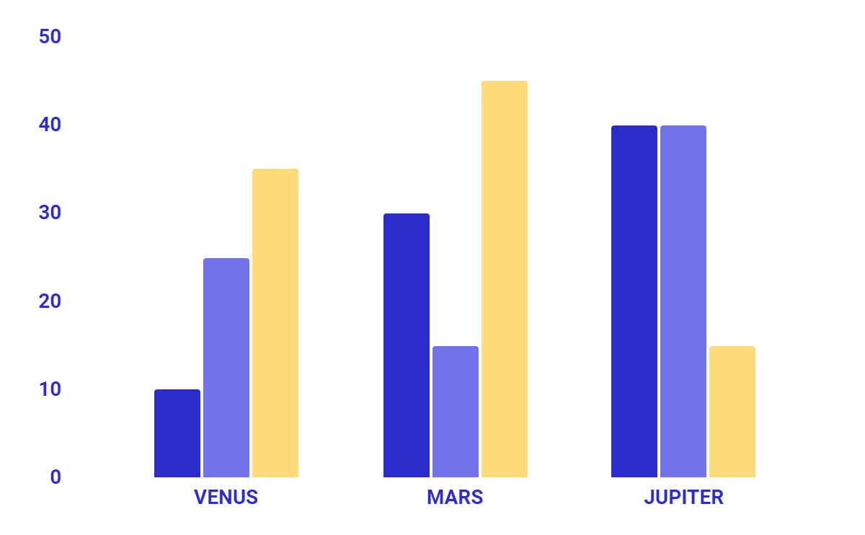
Use graphs
Colors
Use colors to differentiate and compare data
Size
Choose a reasonable size for your graph
Variety
There are line charts, bar charts, area charts, etc.
* To modify this graph, click on it, follow the link, change the data and paste the new graph here, replacing this one

Slide 18
Things to keep in mind
Text
Audience
Storytelling
Fonts
Colors
Images
Summarize the information provided
Adapt the presentation to your audience
Try narrative techniques such as storytelling
Try not to use more than three different fonts
Adapt the colors to the theme and audience
Find quality images, with a reasonable size

Slide 19
3
Happy birthday!
Try to summarize and structure your information nicely!

Slide 20
How about an infographic?
80%
60%
55%
They convey information visually
They catch your public’s attention
They help reduce the amount of text

Slide 21
Things to keep in mind
Free Now

Slide 22
Thanks!
Do you have any questions?

Slide 23
Alternative resources
Vectors
Birthday landing page template
Photos
Birthday cake next to candle
People dancing at a party

Slide 24
Resources
Vectors
Hand-drawn birthday background design
Photos
Person holding birthday cupcake with candle
Still life of tasty birthday cake

Slide 25
https://www.plantillaspower-point.com/

Slide 26
Instructions for use (free users)

Slide 27
Instructions for use (free users)

Slide 28
Instructions for use (free users)

Slide 29
Instructions for use (free users)

Slide 30
Instructions for use (free users)

Slide 31
Instructions for use (free users)

Slide 32
Alternative resources

Slide 33
Fonts & colors used
This presentation has been made using the following fonts:
Montserrat
(https://fonts.google.com/specimen/Montserrat)
#7373eb
#2c2ccc
#01b2ff
#008cf6
#d7f1fe
#0173ef
#ffdb7a
#ff9100
#e29000
##ffffffff

Slide 34





Storyset
Create your Story with our illustrated concepts. Choose the style you like the most, edit its colors, pick the background and layers you want to show and bring them to life with the animator panel! It will boost your presentation. Check out How it Works.
Pana
Amico
Bro
Rafiki
Cuate

Slide 35
JANUARY
FEBRUARY
MARCH
APRIL
MAY
JUNE
PHASE 1
Task 1
Task 2
PHASE 2
Task 1
Task 2
JANUARY
FEBRUARY
MARCH
APRIL
PHASE 1
Task 1
Task 2

Slide 37
...and our sets of editable icons

Slide 40
SEO & Marketing Icons

