Slide 1
ENGLISH
Here is where your presentation begins
ENGLISH

Slide 2
Break Out
Here is where your presentation begins

Slide 3
Table of contents
01
02
No new medication
Keep games gentle
03
04
Bath time instructions
Don’t take photos
You can describe the topic of the section here
You can describe the topic of the section here
You can describe the topic of the section here
You can describe the topic of the section here

Slide 4
Hello!
Free Template
I am Jayden Smith
I am here because I love to give presentations.
You can find me at @username

Slide 5
Whoa!
This can be the part of the presentation where you introduce yourself, write your email...

Slide 6
Don’t cancel at the last minute
Venus
Jupiter
Mars
Saturn
Venus is the second planet from the Sun
It’s the biggest planet in the Solar System
Despite being red, Mars is a cold place
Saturn is a gas giant and has several rings

Slide 7
1.Transition headline
Let’s start with the first set of slides
Quotations are commonly printed as a means of inspiration and to invoke philosophical thoughts from the reader. Quotations are commonly printed as a means of inspiration and to invoke philosophical thoughts from the reader.

Slide 8
01
No new medication
You can enter a subtitle here if you need it

Slide 9
of children have been featured on social media by age two

Slide 10
Infographic Style
Content Here
Content Here
Content Here
Get a modern PowerPoint Presentation that is beautifully designed. You can simply impress your audience and add a unique zing and appeal to your Presentations.
Get a modern PowerPoint Presentation that is beautifully designed. You can simply impress your audience and add a unique zing and appeal to your Presentations.
Get a modern PowerPoint Presentation that is beautifully designed. You can simply impress your audience and add a unique zing and appeal to your Presentations.

Slide 11
Infographic Style
Simple PowerPoint Presentation
Get a modern PowerPoint Presentation that is beautifully designed. Easy to change colors, photos and Text.
Get a modern PowerPoint Presentation that is beautifully designed. Easy to change colors, photos and Text.
Get a modern PowerPoint Presentation that is beautifully designed. Easy to change colors, photos and Text.
Get a modern PowerPoint Presentation that is beautifully designed. Easy to change colors, photos and Text.
Get a modern PowerPoint Presentation that is beautifully designed. Easy to change colors, photos and Text. You can simply impress your audience and add a unique zing and appeal to your Presentations. Get a modern PowerPoint Presentation that is beautifully designed. Easy to change colors, photos and Text. You can simply impress your audience and add a unique zing and appeal to your Presentations. Easy to change colors, photos and Text.
You can simply impress your audience and add a unique zing and appeal to your Presentations. Get a modern PowerPoint Presentation that is beautifully designed. Easy to change colors, photos and Text. You can simply impress your audience and add a unique zing and appeal to your Presentations

Slide 12
Infographic Style
Content Here
Content Here
Content Here
Get a modern PowerPoint Presentation that is beautifully designed. You can simply impress your audience and add a unique zing and appeal to your Presentations.
Get a modern PowerPoint Presentation that is beautifully designed. You can simply impress your audience and add a unique zing and appeal to your Presentations.
Get a modern PowerPoint Presentation that is beautifully designed. You can simply impress your audience and add a unique zing and appeal to your Presentations.

Slide 13
Don’t take children out without asking first
Parents always want to know where their children are
The babysitter should always ask for permission in advance
Mercury is the closest planet to the Sun and the smallest one in the Solar System. This planet’s name has nothing to do with the liquid metal
Venus has a beautiful name and is the second planet from the Sun. It's terribly hot and its atmosphere is extremely poisonous

Slide 14
Infographic Style
Content Here
Content Here
Get a modern PowerPoint Presentation that is beautifully designed. hope and I believe that this Template will your Time. Easy to change colors, photos and Text.
Get a modern PowerPoint Presentation that is beautifully designed. hope and I believe that this Template will your Time. Easy to change colors, photos and Text.
Content Here
Content Here
Get a modern PowerPoint Presentation that is beautifully designed. hope and I believe that this Template will your Time. Easy to change colors, photos and Text.
Get a modern PowerPoint Presentation that is beautifully designed. hope and I believe that this Template will your Time. Easy to change colors, photos and Text.

Slide 15
Use this checklist
Jupiter
Mars
Mercury
Venus

Slide 16
We Create Quality Professional PPT Presentation
Add Contents Title
Simple Presentation
You can simply impress your audience and add a unique zing and appeal to your Presentations.
You can simply impress your audience and add a unique zing and appeal to your Presentations.
You can simply impress your audience and add a unique zing and appeal to your Presentations.
Portfolio
Presentation
You can simply impress your audience and add a unique zing and appeal to your Presentations.
I hope and I believe that this Template will your Time, Money and Reputation. Easy to change colors, photos and text. Get a modern PowerPoint Presentation that is beautifully designed. Get a modern PowerPoint Presentation that is beautifully designed.

Slide 17
Awesome words

Slide 18
Why so sad?
Mars
Mercury
Venus
Saturn
Mars is actually a very cold place
Mercury is the closest planet to the Sun
Venus is the second planet from the Sun
It’s composed of hydrogen and helium

Slide 19
—Someone famous
“This is a quote, words full of wisdom that someone important said and can make the reader get inspired”

Slide 20
A day with children
5:00 pm
9:00 pm
7:00 pm
Play and have fun
Read and sleep
Shower and dinner

Slide 21
A day with children
5:00 pm
9:00 pm
7:00 pm
Play and have fun
Read and sleep
Shower and dinner

Slide 22
A day with children
5:00 pm
9:00 pm
7:00 pm
Play and have fun
Read and sleep
Shower and dinner

Slide 23
02
Keep play gentle
You can enter a subtitle here if you need it

Slide 24
Watch your language
It’s the closest planet to the Sun
Venus is the second planet from the Sun
Mars is actually a very cold place
Jupiter is the biggest planet of them all
It’s composed of hydrogen and helium
It’s the farthest planet from the Sun

Slide 25
Rules at home
Yes
No
Keep games gentle
Don’t watch movies
Respect privacy
Don’t be on your phone

Slide 26
Our children
You can talk a bit about this person here
You can talk a bit about this person here
Timmy Jimmy
Jenna Doe

Slide 27
Favorite activities
65%
30%
Jenna Doe
Water games
Eating
40%
50%
Timmy Jimmy
Playing
Street games

Slide 28
A picture always reinforces the concept
Images reveal large amount of data, so remember: use an image instead of a long text. Your audience will appreciate it

Slide 29
Three columns
Mercury is the closest planet to the Sun
Despite being red, Mars is a cold place
Venus has a beautiful name, but it’s hot

Slide 30
A picture always reinforces the concept
Images reveal large amount of data, so remember: use an image instead of a long text. Your audience will appreciate it

Slide 31
Three columns
Mercury is the closest planet to the Sun
Despite being red, Mars is a cold place
Venus has a beautiful name, but it’s hot

Slide 32
AWESOME
PRESENTATION
EASY TO CHANGE COLORS, PHOTOS.
Saturn
Saturn
It’s composed mostly of hydrogen
It’s composed mostly of hydrogen
Saturn
Saturn
It’s composed mostly of hydrogen
It’s composed mostly of hydrogen

Slide 33
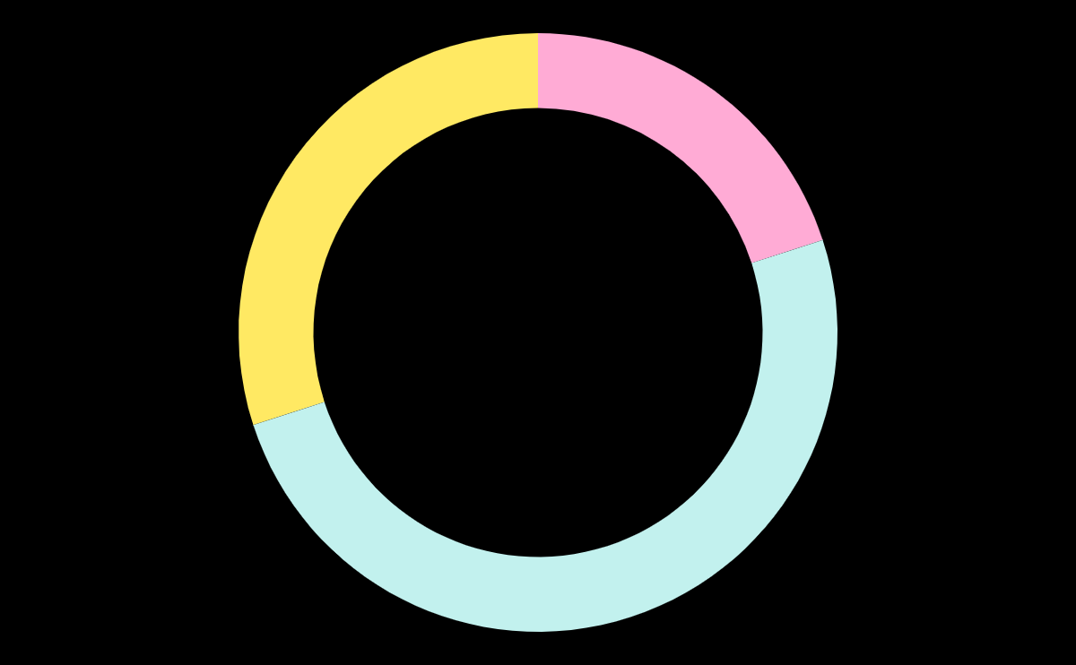
This is a graph
Mercury
Mars
Saturn
Mercury is the smallest planet
Mars is actually a cold place
It’s composed mostly of hydrogen

Slide 34
78%
2h 15m
30%
children pick up on language
limit of TV time
bad experiences with babysitters

Slide 35
Infographics make your idea understandable
Mercury is the closest planet to the Sun
Venus has a beautiful name and is hot
Despite being red, Mars is a cold place
Saturn is a gas giant and has a several rings

Slide 36
AWESOME
PRESENTATION
EASY TO CHANGE COLORS, PHOTOS.
Get a modern PowerPoint
You can simply impress your audience and add a unique zing and appeal to your Presentations. Easy to change colors, photos and Text. Get a modern PowerPoint Presentation that is beautifully designed. You can simply impress your audience and add a unique zing and appeal to your Presentations. You can simply impress your audience and add a unique zing and appeal to your Presentations.

Slide 37
Activities you can do
Lists like this one
They’re simple
You can organize your ideas clearly
You’ll never forget to buy milk!

Slide 38
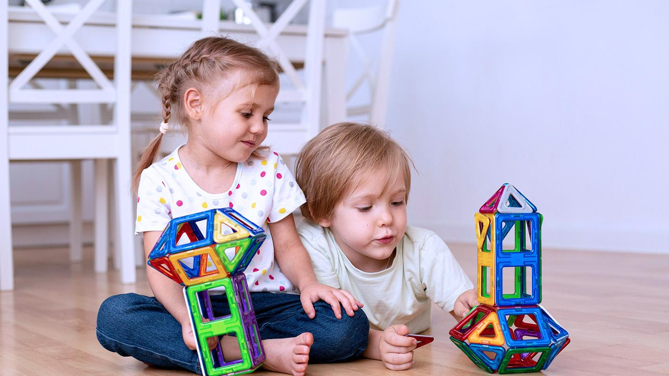
A picture is worth a thousand words
You can replace the image on the screen with your own work. Just right-click on it and select “Replace image”

Slide 39
Desktop software
You can replace the image on the screen with your own work. Just right-click on it and select “Replace image”

Slide 40
03
Bath instructions
You can enter a subtitle here if you need it

Slide 41
Some percentages
Mars
Mercury
Saturn
Venus
85%
Mars is actually a very cold place
50%
The closest planet to the Sun
15%
It’s a gas giant and has rings
35%
It has a beautiful name and is hot

Slide 42
Who is the baby?
Name: Jenna Doe
Age: 5
Jupiter
Venus
Mercury

Slide 43
Conclusion
Mercury is the closest planet to the Sun and the smallest one in the Solar System—it’s only a bit larger than our Moon. The planet’s name has nothing to do with the liquid metal since it was named after the Roman messenger god

Slide 44
Thanks!
Do you have any questions?
youremail@freepik.com
+91 620 421 838
yourcompany.com
Please keep this slide for attribution

Slide 45
www.plantillaspower-point.com

Slide 46
Babysitting rules icons

Slide 47
Alternative resources

Slide 48
Alternative resources

Slide 49
Alternative resources

Slide 50
Alternative resources

Slide 51
Alternative resources

Slide 52
Alternative resources

Slide 53
...and our sets of editable icons
You can resize these icons without losing quality.
You can change the stroke and fill color; just select the icon and click on the paint bucket/pen.
In Google Slides, you can also use Flaticon’s extension, allowing you to customize and add even more icons.

Slide 54
Educational Icons
Medical Icons

