Slide 1
TREES
Free Template
Here is where your presentation begins

Slide 2
Change your background
To help limit distractions or make video calls more fun, you can now blur your background or replace your background with an image

Slide 3
Table of contents
01
03
02
04
Backgrounds
Reminder
You can describe the topic of the section here
You can describe the topic of the section here
Avatars
Planning
You can describe the topic of the section here
You can describe the topic of the section here

Slide 4
TABLE OF CONTENTS
ABOUT TREES
TYPES OF TREES
01
02
PARTS OF A TREE
ACTIVITIES
03
04
Here you can describe the topic of the section
Here you can describe the topic of the section
Here you can describe the topic of the section
Here you can describe the topic of the section

Slide 5
WHOA!
This can be the part of the presentation where you introduce yourself, write your email...

Slide 6
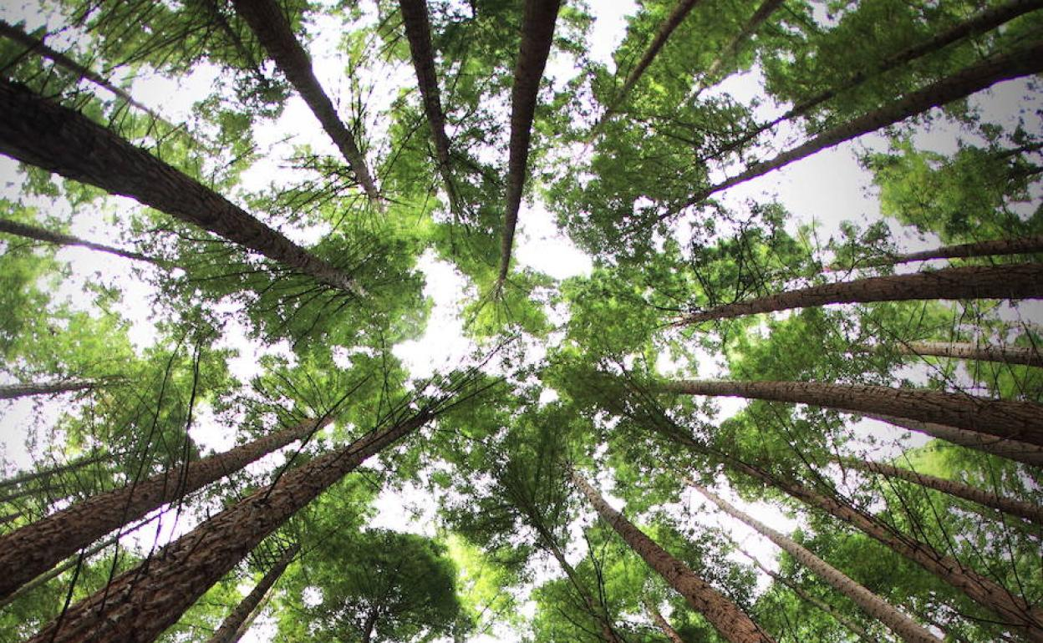
Awesome Words

Slide 7
—SOMEONE FAMOUS
“This is a quote, words full of wisdom that someone important said and can make the reader get inspired.”

Slide 8
Customize it
Images reveal large amounts of data, so remember: use an image instead of long texts
Images reveal large amounts of data, so remember: use an image instead of long texts
Images reveal large amounts of data, so remember: use an image instead of long texts

Slide 9
01
ABOUT TREES
You can enter a subtitle here if you need it

Slide 10
INTRODUCTION
You can give a brief description of the topic you want to talk about here. For example, if you want to talk about Mercury, you can say that it’s the smallest planet in the entire Solar System

Slide 11
THE SLIDE TITLE GOES HERE!
Do you know what helps you make your point clear?
Lists like this one:
They’re simple
You can organize your ideas clearly
You’ll never forget to buy milk!
And the most important thing: the audience won’t miss the point of your presentation

Slide 12
AWESOME WORDS

Slide 13
What materials must I bring to class?
Notes
Eraser
Rounded scissors
Pencils
Stapler
Calculator
Markers

Slide 14
02
TYPES OF TREES
You can enter a subtitle here if you need it

Slide 15
BASED ON LEAVES
DECIDUOUS TREES
EVERGREEN TREES
Mercury is the closest planet to the Sun and the smallest one in the Solar System. This planet’s name has nothing to do with the liquid metal
Venus has a beautiful name and is the second planet from the Sun. It’s hot and is the second-brightest natural object in the night sky

Slide 16
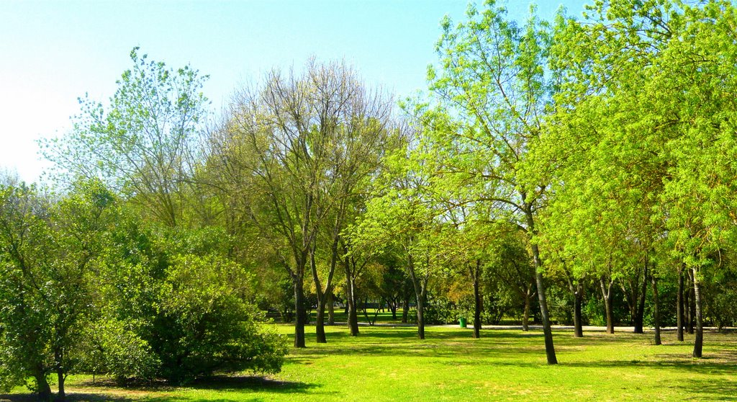
A picture is worth a thousand words

Slide 17
SOME SPECIES OF TREES
WILLOW
POPLAR
MAPLE
PALM
SPRUCE
OAK
Mercury is the smallest planet in the Solar System
Venus is the second planet from the Sun
Despite being red, Mars is actually a cold place
Jupiter is the biggest planet in the Solar System
Saturn is composed of hydrogen and helium
Neptune is the farthest planet from the Sun

Slide 18
Infographic
Saturn
Mercury
Saturn is composed of hydrogen and helium
Mercury is the closest planet to the Sun
Neptune
Mars
Neptune is the farthest from the Sun
Despite being red, Mars is a cold place

Slide 19
POPULAR USES
FOOD
TIMBER
FUEL
Mercury is the closest planet to the Sun and the smallest in the Solar System
Venus has a beautiful name and is the second planet from the Sun
Despite being red, Mars is actually a cold place. It’s full of iron oxide dust

Slide 20
DIAGRAM: LEAVES
LEAVES
EVERGREEN
DECIDUOUS
MERCURY
JUPITER
VENUS
SATURN
Mercury is the smallest planet in the Solar System
Jupiter is a gas giant and the biggest planet of them all
It has a beautiful name, but also high temperatures
Saturn is composed mostly of hydrogen and helium

Slide 21
Infographic
Mars
Saturn
Jupiter
Despite being
red, Mars is a
cold place
It’s composed
of hydrogen
and helium
Jupiter is a gas giant and the biggest planet

Slide 22
THIS IS A TABLE
SPECIE | TYPE OF LEAF | PLANTING SEASON
WILLOW | Deciduous | Summer
PALM | Evergreen | Spring
OAK | Deciduous | Summer
MAPLE | Deciduous | Fall

Slide 23
03
PARTS OF A TREE
You can enter a subtitle here if you need it

Slide 24
PARTS OF A TREE
01
02
BRANCH
FOLIAGE
03
04
ROOT
TRUNK
Mars is actually a very cold place
Venus is the second planet from the Sun
Saturn is composed of hydrogen and helium
Jupiter is the biggest planet of them all

Slide 25
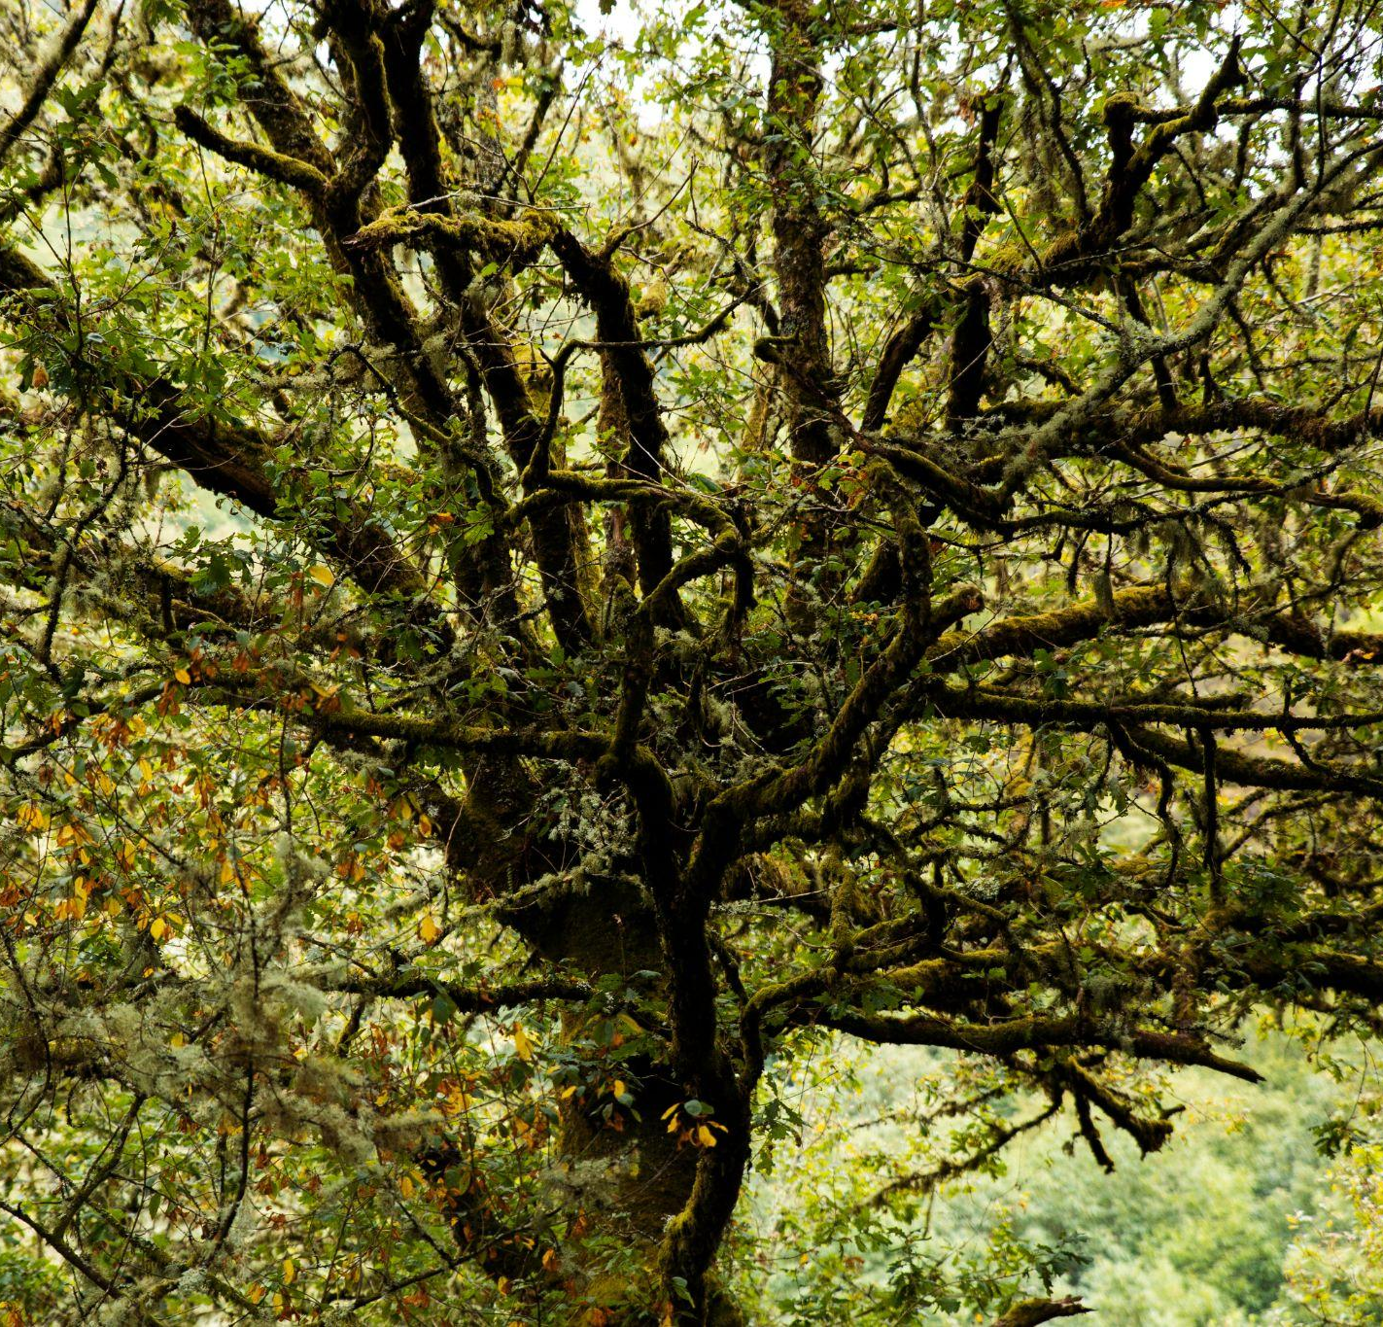
A PICTURE ALWAYS REINFORCES THE CONCEPT
Images reveal large amounts of data, so remember: use an image instead of a long text. Your audience will appreciate it

Slide 26
OTHER PARTS OF A TREE
WOOD
RINGS
BARK
LEAF
Mercury is the closest planet to the Sun
Venus is the second planet from the Sun
Jupiter is the biggest planet in the Solar System
Saturn is composed of hydrogen and helium

Slide 27
PARTS
SATURN
Saturn is a gas giant and has rings
MERCURY
It’s the closest planet to the Sun
VENUS
Venus is the second planet from the Sun

Slide 28
3.04 TRILLIONS
of trees in the world
Saturn is composed of hydrogen and helium

Slide 29
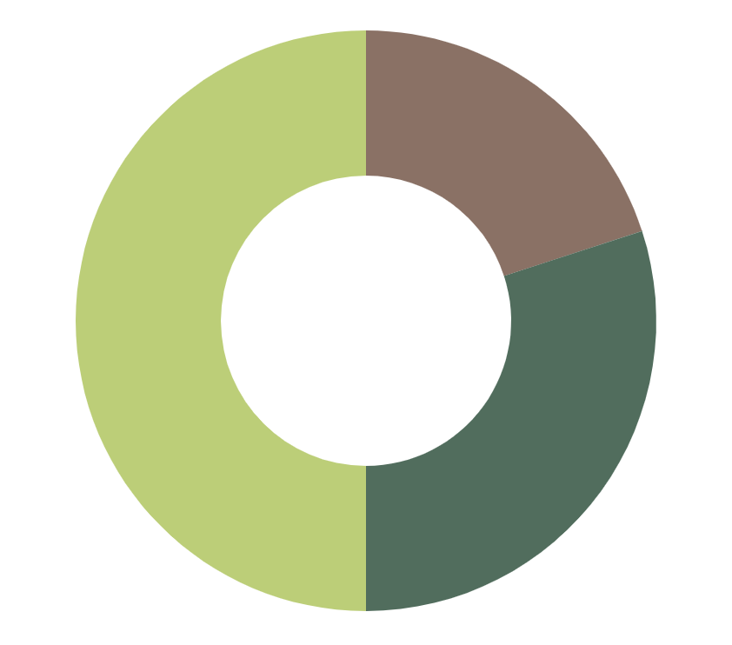
THIS IS A GRAPH
MARS
50%
Despite being red, Mars is actually a cold place
NEPTUNE
20%
Neptune is the farthest planet from the Sun
SATURN
30%
Saturn is composed of hydrogen and helium
Follow the link in the graph to modify its data and then paste the new one here. For more info, click here

Slide 30
333,000.000
386,000 km
9h 55m 23s
The Sun’s mass compared to Earth’s
Distance between Earth and the Moon
Jupiter's rotation period

Slide 31
SEASONS AND TREES
FALL
SPRING
Saturn is composed of hydrogen and helium
Neptune is the farthest planet from the Sun
01
02
03
04
SUMMER
WINTER
Venus is the second planet from the Sun
Despite being red, Mars is actually a cold place

Slide 32
CONCLUSIONS
Write here your conclusions
Write here your conclusions
Write here your conclusions
Write here your conclusions
Write here your conclusions
Write here your conclusions

Slide 33
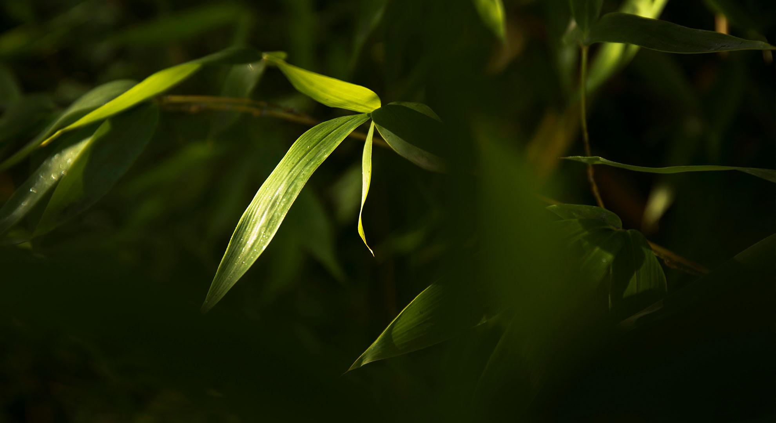
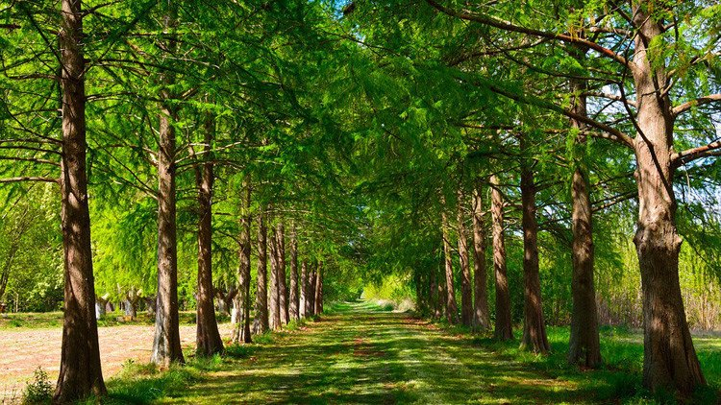
A PICTURE IS WORTH A THOUSAND WORDS

Slide 34
04
ACTIVITIES
You can enter a subtitle here if you need it

Slide 35
MATCH THE TREES WITH THEIR TYPE OF LEAVES
EVERGREEN
DECIDUOUS
You can replace the image on the screen with your own work. Just right-click on it and select “Replace image”
You can replace the image on the screen with your own work. Just right-click on it and select “Replace image”

Slide 36
IDENTIFY THE SEASON
WRITE HERE
WRITE HERE
WRITE HERE
WRITE HERE

Slide 37
OUR TEAM
JENNA DOE
SUSAN SMITH
You can talk a bit about this person here
You can talk a bit about this person here

Slide 38
Our team
Helena James
You can replace the image on the screen with your own
John Doe
You can replace the image on the screen with your own

Slide 39
This is a graph
Mars 40%
Despite being red, Mars is a cold place
Neptune 35%
Neptune is the farthest from the Sun
Saturn 25%
It’s composed of hydrogen and helium
To modify this graph, click on it, follow the link, change the data and paste the resulting graph here, replacing this one

Slide 40
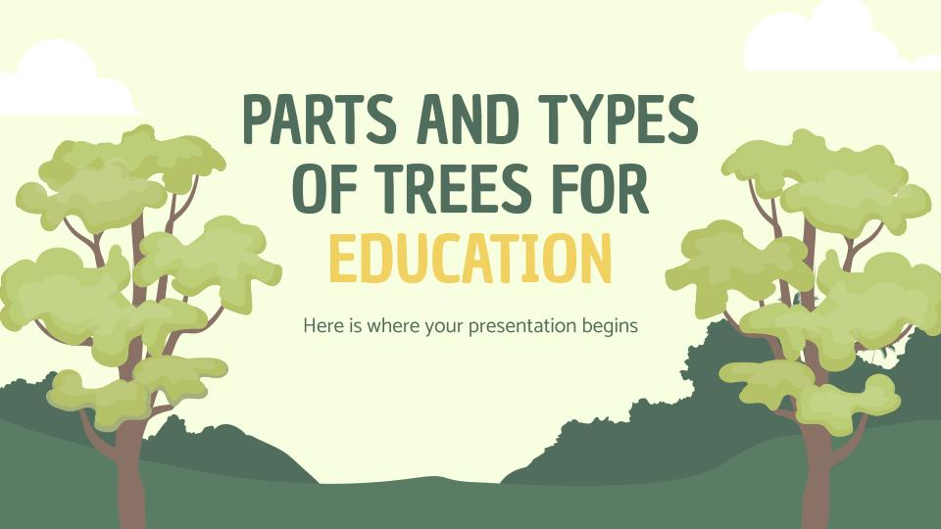
MOCKUP: PC
You can replace the image on the screen with your own work. Just right-click on it and select “Replace image”
You can replace the image on the screen with your own work. Just right-click on it and select “Replace image”

Slide 41
THANKS!
Do you have any questions?

Slide 42
www.plantillaspower-point.com

Slide 43
ALTERNATIVE ICONS

Slide 44
ALTERNATIVE ICONS

Slide 45
ALTERNATIVE ICONS

Slide 46
ALTERNATIVE ICONS

Slide 47
ALTERNATIVE ICONS

Slide 48
Help & Support Icons
Avatar Icons

Slide 49
Nature Icons

Slide 50
SEO & Marketing Icons

