Slide 1
CAMERAS
Free Template
plantillaspower-point.com
Notes:
plantillaspower-point.com

Slide 2
Table of contents
01
02
03
About the patient
Discussion
Diagnosis
You can describe the topic of the section here
You can describe the topic of the section here
You can describe the topic of the section here
04
05
Treatment
Patient monitoring
You can describe the topic of the section here
You can describe the topic of the section here
Notes:
plantillaspower-point.com

Slide 3
Review of systems
Do you know what helps you make your point crystal clear?
Lists like this one:
They’re simple
You can organize your ideas clearly
You’ll never forget to buy milk!
And the most important thing: the audience won’t miss the point of your presentation
Notes:
plantillaspower-point.com

Slide 4
TABLE OF CONTENTS
01
THEORY LESSON
03
FEATURES OF THE TOPIC
You can describe the topic of the section here
You can describe the topic of the section here
02
UNDERSTAND CAMERA
04
PRACTICAL EXERCISE
You can describe the topic of the section here
You can describe the topic of the section here
Notes:
plantillaspower-point.com

Slide 5
INTRODUCTION
Venus has a beautiful name and is the second planet from the Sun. It’s terribly hot and its atmosphere is extremely poisonous
Notes:
plantillaspower-point.com

Slide 6
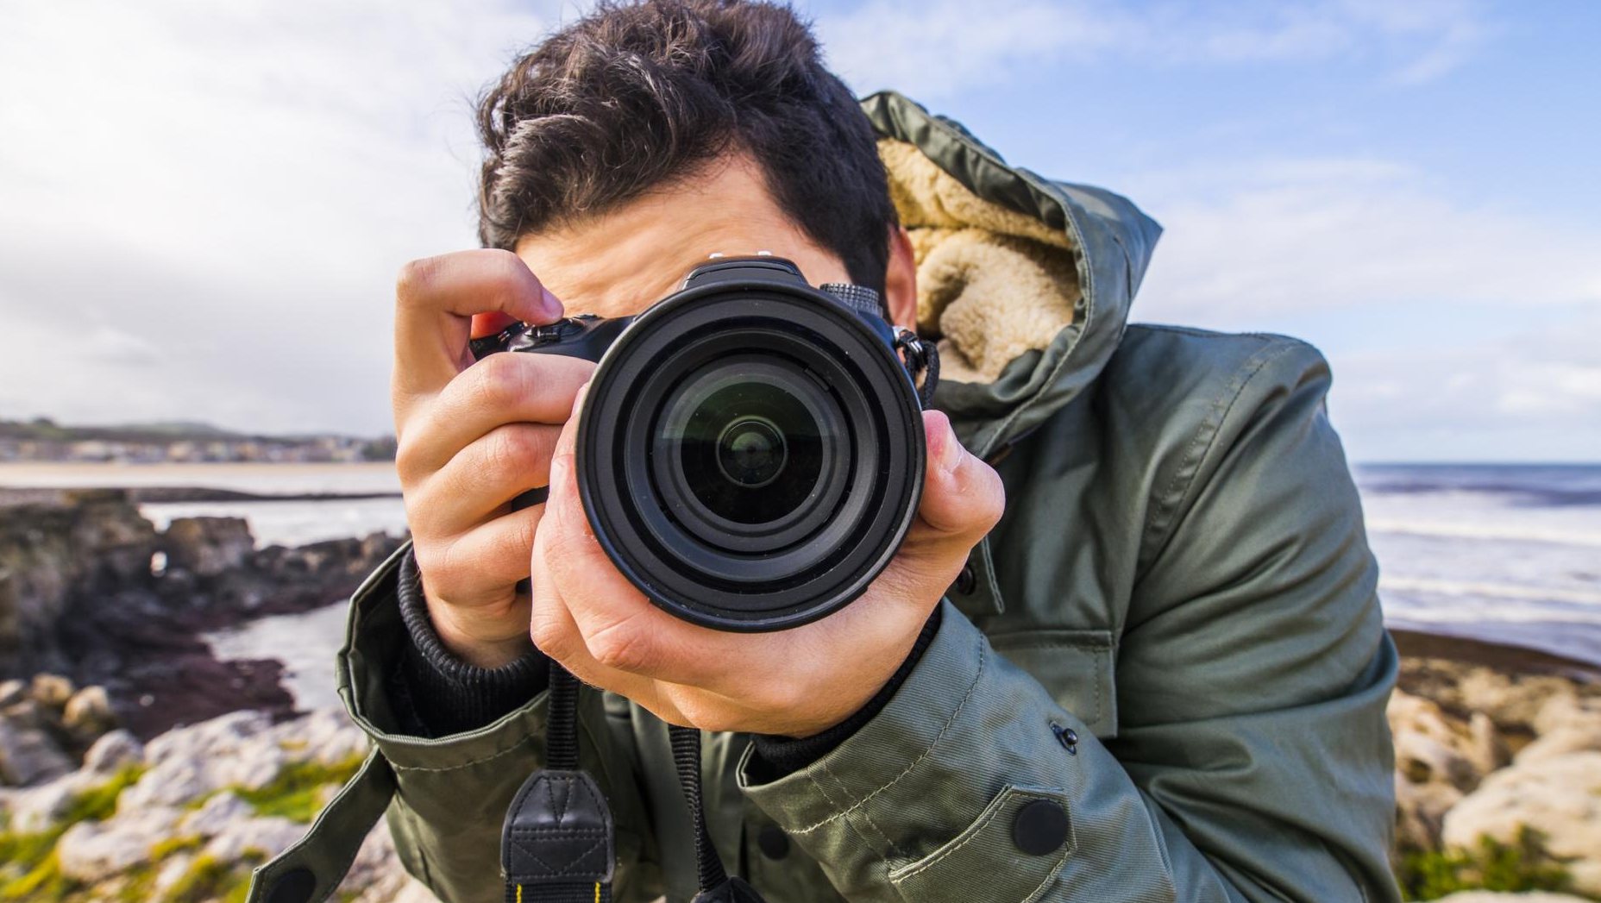
AWESOME WORDS
Notes:
plantillaspower-point.com

Slide 7
01
THEORY LESSON
You can enter a subtitle here if you need it
Notes:
plantillaspower-point.com

Slide 8
EXPOSURE CONTROL
APERTURE AND DIAPHRAGM
SHUTTER AND TIME
Despite being red, Mars is a cold place. It’s full of iron oxide dust, which gives the planet its reddish cast
It’s the closest planet to the Sun and the smallest one in the Solar System—it’s only a bit larger than the Moon

Slide 9
Physical examination
Venus
Venus has extremely high temperatures
Mercury
Mercury is the smallest planet of them all
Jupiter
Jupiter is a gas giant and the biggest planet

Slide 10
AWESOME WORDS
Images reveal large amounts of data, so remember use an image instead of a long text. Your audience will appreciate it
Images reveal large amounts of data, so remember use an image instead of a long text. Your audience will appreciate it
Notes:
plantillaspower-point.com

Slide 11
UNDERSTANDING EXPOSURE
METERING
SPEED SETTING
DEPT OF FIELD
Neptune is the farthest planet from the Sun
It’s terribly hot, even hotter than Mercury
Mercury is the closest planet to the Sun

Slide 12
A picture always reinforces the concept
Images reveal large amounts of data, so remember: use an image instead of long texts
Images reveal large amounts of data, so remember: use an image instead of long texts
Notes:
plantillaspower-point.com

Slide 13
FEATURES OF THE TOPIC
CAMERA BODY
LENS
It’s still the only world known to support life
It has a beautiful name, but it’s terribly hot
BATTERY
MEMORY CARD
It’s the biggest planet in the Solar System
Despite being red, Mars is a cold place
Notes:
plantillaspower-point.com

Slide 14
Infographic Style
Content Here
You can simply impress your audience and add a unique zing and appeal to your Presentations.
99%
Content Here
You can simply impress your audience and add a unique zing and appeal to your Presentations.
85%
Content Here
You can simply impress your audience and add a unique zing and appeal to your Presentations.
67%
Notes:
plantillaspower-point.com

Slide 15
Discussion summary
Images reveal large amounts of data, so remember: use an image instead of a long text. Your audience will appreciate it

Slide 16
A PICTURE REINFORCE THE CONCEPT
Images reveal large amounts of data, so remember: use an image instead of a long text

Slide 17
EXAMPLE
CONTROL DIAL
VISOR
Saturn has several rings
Mars is a cold place
SHUTTER
LENS MOUNT
The Moon is a satellite
Jupiter is a gas giant
BATTERY
SENSOR
It’s the smallest planet
Earth is full of life

Slide 18
“There are no rules for good photographs, there are only good photographs”
—SOMEONE FAMOUS
Notes:
plantillaspower-point.com

Slide 19
A PICTURE ALWAYS REINFORCES THE CONCEPT
Images reveal large amounts of data, so remember: use an image instead of a long text. Your audience will appreciate that
Images reveal large amounts of data, so remember: use an image instead of a long text. Your audience will appreciate that

Slide 20
1933
1885
1990
is the year of the first cameras SLR with 35mm film
is the year that paper film manufacturing started
is the year the first digital cameras were marketed

Slide 21
TIMELINE
1885
1920
1990
Mercury is the closest planet to the Sun
It’s the farthest planet from the Sun
It’s terribly hot, even hotter than Mercury
PHASE 1
PHASE 3
PHASE 5
PHASE 2
PHASE 4
Saturn is the ringed one and a gas giant
It’s the biggest planet in the Solar System
1893
1950
Notes:
plantillaspower-point.com

Slide 22
7 hours
Is the time that the shutter remained open exposing in earlies cameras

Slide 23
SOME PERCENTAGES
75%
55%
37%
SHUTTER
F-NUMBER
WHITE BALANCE
Jupiter is a gas giant and the biggest planet in the Solar System
Mercury is the closest planet to the Sun and the smallest one
Mars is a dusty, cold, desert world with a very thin atmosphere

Slide 24
OTHER CONCEPTS
FLASH
REMOTE SHUTTER
Mercury is the closest planet to the Sun
It’s the farthest planet from the Sun
LENS HOOD
LENS FILTERS
Saturn is the ringed one and a gas giant
It’s the biggest planet in the Solar System
Notes:
plantillaspower-point.com

Slide 25
PRACTICAL EXERCISE
Take a photo day by day, at least for a week, and complete the information
Date
Hour
Camera
Focal Length
Aperture
Shutter Speed
White Balance
Style

Slide 26
HYPERFOCAL DISTANCE TABLE
Focal Length / Aperture
 | F/2.8 | F/4 | F/5.6 | F/8 | F/11 | F/16 | F/22
16mm | 10 | 7 | 5 | 3.6 | 2.5 | 1.8 | 1.3
20mm | 15.5 | 11 | 7.8 | 5.5 | 3.9 | 2.8 | 2
24mm | 22.3 | 15.8 | 11.2 | 8 | 5.7 | 4 | 2.9
28mm | 30.4 | 21.5 | 15.2 | 10.8 | 7.7 | 5.5 | 3.9
35mm | 47.5 | 33.6 | 23.8 | 17 | 12 | 8.5 | 6
50mm | 96.8 | 68.5 | 48.5 | 34 | 23 | 17.1 | 11.9
Distance in Feet

Slide 27

THIS IS A GRAPH!
34%
22%
CONTROL DIAL
VISOR
Saturn has several rings
Mars is a cold place
11%
32%
SHUTTER
LENS MOUNT
The Moon is a satellite
Jupiter is a gas giant
Follow the link in the graph to modify its data and then paste the new one here. For more info, click here

Slide 28
MOST PHOTOGRAPHED PLACES
CENTRAL PARK
It’s the smallest planet
BIG BEN
Mars is a cold place
SPAIN SQUARE
Jupiter is a gas giant
ALHAMBRA
Earth is full of life
Notes:
plantillaspower-point.com

Slide 29
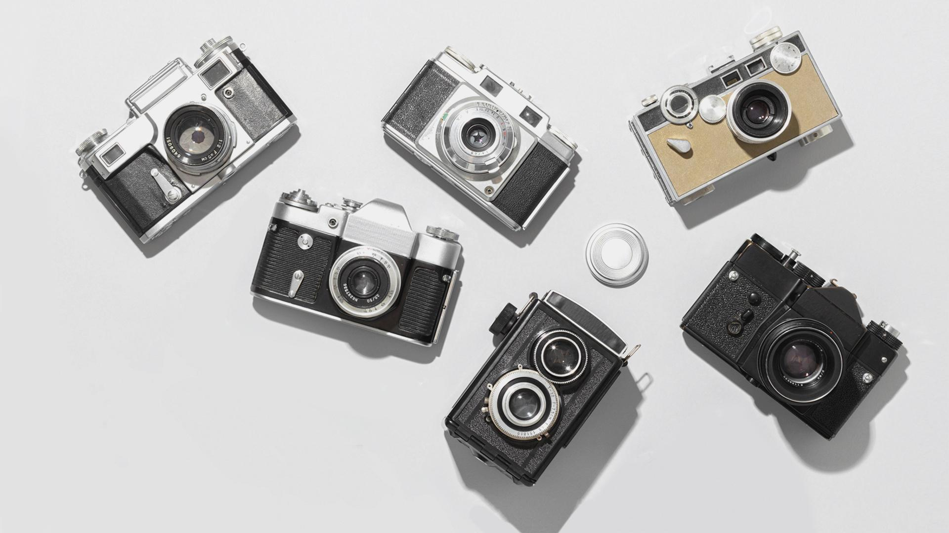
A PICTURE IS WORTH A THOUSANDS WORDS

Slide 30
DO YOU WANT TO KEEP LEARNING?
AUTHOR (YEAR). Title of the publication. Publisher
AUTHOR (YEAR). Title of the publication. Publisher
AUTHOR (YEAR). Title of the publication. Publisher
AUTHOR (YEAR). Title of the publication. Publisher
AUTHOR (YEAR). Title of the publication. Publisher
AUTHOR (YEAR). Title of the publication. Publisher

Slide 31
Our team
Jenna Doe
Mike Bones
You can speak a bit about this person here
You can speak a bit about this person here

Slide 32

SNEAK PEEK
You can replace the image on the screen with your own work. Right click on it and choose "Replace image" so you can add yours
Notes:
plantillaspower-point.com

Slide 33
DISCUSSION SUMMARY
01
02
Mercury is the closest planet to the Sun and the smallest one in the Solar System—it’s only a bit larger than our Moon
Mercury is the closest planet to the Sun and the smallest one in the Solar System—it’s only a bit larger than our Moon

Slide 34
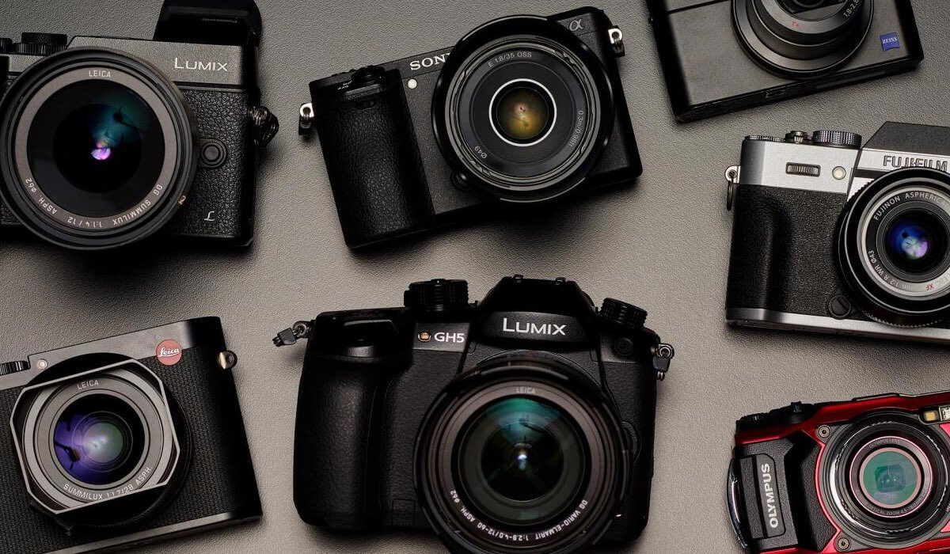
A PICTURE IS WORTH A THOUSAND WORDS
Earth is the third planet from the Sun and the only one that harbors life in the Solar System. This is where we all live

Slide 35
Conclusions
Sun and the Free Template
Earth is the third planet from the Sun and the only one that harbors life in the Solar System. This is where we all live
Earth is the third planet from the Sun and the only one that harbors life in the Solar System. This is where we all live
Notes:
plantillaspower-point.com

Slide 36
AWESOME
WORDS
You can simply impress your audience and add a unique zing and appeal to your Presentations. Get a modern PowerPoint Presentation that is beautifully designed. I hope and I believe that this Template will your Time, Money and Reputation.

Slide 37
THANKS!
Do you have any questions?
Earth is the third planet from the Sun and the only one that harbors life in the Solar System. This is where we all live
Earth is the third planet from the Sun and the only one that harbors life in the Solar System. This is where we all live
www.plantillaspower-point.com

Slide 38
www.plantillaspower-point.com

Slide 39
RESOURCES
www.plantillaspower-point.com
Notes:
plantillaspower-point.com

Slide 40
ALTERNATIVE RESOURCES
www.plantillaspower-point.com

Slide 41
ALTERNATIVE RESOURCES
www.plantillaspower-point.com

Slide 42
...and our sets of editable icons
www.plantillaspower-point.com

