Slide 1
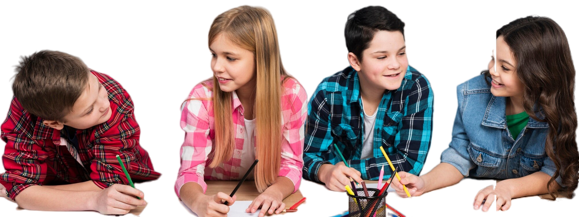
COMMUNICATION CLASSES
www.plantillaspower-point.com
FREE TEMPLATE

Slide 2
TABLE OF CONTENTS
Infographic Style
EASY TO CHANGE COLORS.
You can simply impress your audience and add a unique zing and appeal to your Presentations.
EASY TO CHANGE COLORS.
You can simply impress your audience and add a unique zing and appeal to your Presentations.
EASY TO CHANGE COLORS.
You can simply impress your audience and add a unique zing and appeal to your Presentations.

Slide 3
TABLE OF CONTENTS
Summarizing
01
Comprehension
02
Activities
03
You can describe the topic of the section here
You can describe the topic of the section here
You can describe the topic of the section here

Slide 4
Real Estate Infographics
Mars
Jupiter
Saturn
Despite being red, Mars is actually a cold place. It’s full of iron oxide dust
It’s a gas giant and the biggest planet in the Solar System
Saturn is a gas giant, composed mostly of hydrogen and helium

Slide 5
THE PROBLEM
Mercury is the closest planet to the Sun and the smallest one in the Solar System. It’s only a bit larger than the Moon.
Mercury is the closest planet to the Sun and the smallest one in the Solar System. It’s only a bit larger than the Moon.
Mercury is the closest planet to the Sun and the smallest one in the Solar System. It’s only a bit larger than the Moon.

Slide 6
READ
This can be the part of the presentation where you can introduce yourself, write your email…

Slide 7
LIST OF BOOKS TO READ THIS YEAR
“Mars is a cold place” - (Author)
“Saturn and venus” - (Author)
“Our planet” - (Author)
“Solar system” - (Author)
“The closest planet to the sun” - (Author)
“Mars is a cold place” - (Author)
“Saturn and venus” - (Author)
“Our planet” - (Author)
“Solar system” - (Author)
“The closest planet to the sun” - (Author)

Slide 8
SOLUTION
Mercury is the closest planet to the Sun and the smallest one in the Solar System. It’s only a bit larger than the Moon.
Mercury is the closest planet to the Sun and the smallest one in the Solar System. It’s only a bit larger than the Moon.
Mercury is the closest planet to the Sun and the smallest one in the Solar System. It’s only a bit larger than the Moon.
Mercury is the closest planet to the Sun and the smallest one in the Solar System. It’s only a bit larger than the Moon.

Slide 9
SUMMARIZING AND ACTIVITIES
01
You can enter a subtitle here if you need it

Slide 10
Read
Underline
HOW TO MAKE A SUMMARY?
Summary
ACTIVITY 1: SUMMARIZING
Mercury is the closest planet to the Sun and the smallest in the Solar System
Venus has a beautiful name and is the second planet from the Sun
Despite being red, Mars is actually a cold place. It’s full of iron oxide dust

Slide 11
ACTIVITY 1: SUMMARIZING
READ: CHAPTER 3
SUMMARY 1
“Write your answer here”
Venus has a beautiful name and is the second planet from the Sun. It’s terribly hot, even hotter than Mercury, and its atmosphere is extremely poisonous. It’s the second-brightest natural object in the night sky after the Moon. Mercury is the closest planet to the Sun and the smallest one in the Solar System...
SUMMARY 2
“Write your answer here”

Slide 12
PARTS OF THE PLOT
Characters
Mercury is the closest planet to the Sun and the smallest one in the Solar System—it’s only a bit larger than the Moon
Settings
Venus has a beautiful name and is the second planet from the Sun. It’s hot and has a very poisonous atmosphere too

Slide 13
Infographic Style
Content Here
You can simply impress your audience and add a unique zing and appeal to your Presentations.
99%
Content Here
You can simply impress your audience and add a unique zing and appeal to your Presentations.
85%
Content Here
You can simply impress your audience and add a unique zing and appeal to your Presentations.
67%

Slide 14
ACTIVITY 2: ANALYZE AND EXPLAIN
WHAT IS THE IMPACT OF THE CHARACTERS AND SETTINGS WITHIN THE PLOT?
HOW DO THESE RELATIONSHIPS AFFECT THE CENTRAL CONFLICT LEADING TO THE CLIMAX AND RESOLUTION?
“Write your answer here”
“Write your answer here”

Slide 15
PLOT, CHARACTERS AND SETTING
Plot
Character
Setting
Mercury is the closest planet to the Sun and the smallest of them all
Venus has a beautiful name and is the second planet from the Sun
Despite being red, Mars is actually a cold place. It’s full of iron oxide dust

Slide 16
ACTIVITY 3: IDENTIFY
Identify the ways major and minor conflicts affect character’s actions by comparing actions, setting(s), symbolism, and plot from various literary texts
MAJOR CONFLICT
MINOR CONFLICT
“Write your answer here”
“Write your answer here”
ACTIONS
SETTING(S)
SYMBOLISM
PLOT
“Write your answer here”
“Write your answer here”
“Write your answer here”
“Write your answer here”

Slide 17
PHYSICAL EXAMINATION
MERCURY
Mercury is very small
VENUS
Venus is a hot planet
JUPITER
Jupiter is the biggest planet

Slide 18
MAIN IDEA & SUPPORTING DETAILS - NON FICTION
Identify
Summarize
Explain
Share
Venus is the second planet from the Sun
Neptune is very far from the Sun
Mercury is the smallest planet
Saturn is the only planet with rings

Slide 19
IT’S TIME TO READ!

Slide 20
ACTIVITY 4: EXPLAIN MAIN IDEA
Summarize or explain the main idea(s) using the supporting details in an expository text
SUPPORTING DETAILS
01
“Write your answer here”
MAIN IDEA
“Write your answer here”
03
“Write your answer here”

Slide 21
STRATEGIES TO IMPROVE READING COMPREHENSION
Read aloud
Promote more
Talk to the teacher
Provide books
Reread the book
Talk about the book
01
04
Mars is actually a very cold place
Saturn is the planet with rings
02
05
Mercury is the smallest planet
Neptune is far from the Sun
03
06
Venus has a beautiful name
Jupiter is the biggest planet

Slide 22


REMEMBER TO REREAD AND SUMMARIZE

Slide 23
Followers best awesome
God
Man
Despite being red, Mars is a cold place
Venus is the second planet from the Sun
Salvation
Character
Neptune is far away from Earth
Mercury is the closest planet to the Sun

Slide 24
ACTIVITY 5: MAIN IDEA AND THEME
Identify, summarize, or explain the main idea(s) or theme(s) using the supporting details and symbolism in a literary text
MAIN IDEA
THEME
“Write your answer here”
“Write your answer here”
“Write your answer here”
“Write your answer here”
“Write your answer here”
“Write your answer here”

Slide 25
ACTIVITY 6: CAUSE AND EFFECT
Identify cause and effect relationships that involve characters and events, and distinguishing cause from effect in literary and expository texts
CAUSE 1
EFFECT 1
“Write your answer here”
“Write your answer here”
CAUSE 2
EFFECT 2
“Write your answer here”
“Write your answer here”

Slide 26
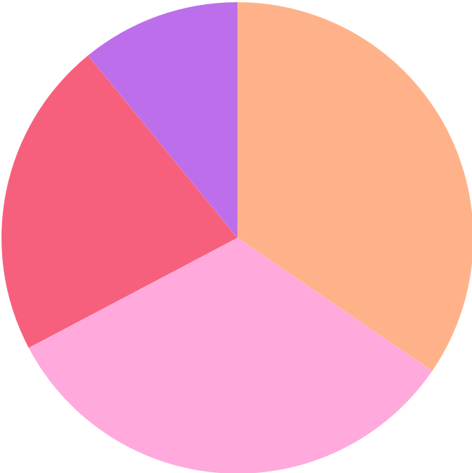
ACTIVITY 7: READ AND INTERPRET
01
WHAT DO THE SLICES OF THE PIE CHART REPRESENT?
“Write your answer here”
02
WHO MIGHT NEED TO KNOW THIS INFORMATION?
“Write your answer here”
38% BUTTER
24% BUTTER
03
WHAT TYPE OF NONFICTION TEXT WAS TAKEN FROM?
36% FLOUR
12% EGG
Follow the link in the graph to modify its data and then paste the new one here. For more info, click here
“Write your answer here”

Slide 27
READ AT HOME
Images reveal large amounts of data, so remember: use an image instead of a long text. Your audience will appreciate it

Slide 28
ACTIVITY 8: AUTHOR'S PURPOSE
Identify and use knowledge of the author’s purpose by analyzing how the literary techniques of mood and tone affects author’s perspective
01
A MAP OF THE WORLD, SHOWING ALL CONTINENTS, COUNTRIES AND OCEANS?
Entertain
Inform
Persuade
02
THE PLAY “ROMEO AND JULIET” BY WILLIAM SHAKESPEARE
Entertain
Inform
Persuade
03
THE LYRICS TO A SONG WRITTEN BY POPULAR MUSIC GROUP
Entertain
Inform
Persuade

Slide 29
ACTIVITY 9: DRAWING CONCLUSIONS
Use knowledge, information, and ideas from literary texts, expository texts, or from multiple sources to make inferences about the text(s)
01
MY FRIEND DIDN’T COME TO MY PARTY
Thus,
“Write your answer here”
02
I PREPARED WELL FOR THE BASKETBALL GAME
Thus,
“Write your answer here”
03
I DID NOT STUDY FOR MY TEST
Thus,
“Write your answer here”

Slide 30
ACTIVITY 10: COMPARE AND CONTRAST
Compare and contrast information and ideas within a text or between two or more texts, including metaphors and point
“Write your answer here”
CHARACTER 1
“Write your answer here”
BOTH
CHARACTER 2
“Write your answer here”

Slide 31
—Paul Sweeney
“You know you’ve read a good book when you turn the last page and feel a little as if you have lost a friend”

Slide 32
1,500
words are enough for a good reading comprehension

Slide 33
100
200
500
EVALUATION RESULTS
is the minimum of words to decode or identify and pronounce words
words in one minute is the amount we can read and assimilate
words per minute is to difficult to process according to the experts

Slide 34
EVALUATION RESULTS
35%
60%
87%
INTERESTING
VOCABULARY
UNDERSTANDING
Mercury is the smallest planet in the Solar System of them all
Venus has a beautiful name and is the second planet from the Sun
Despite being red, Mars is actually a cold place. It’s full of iron oxide dust

Slide 35
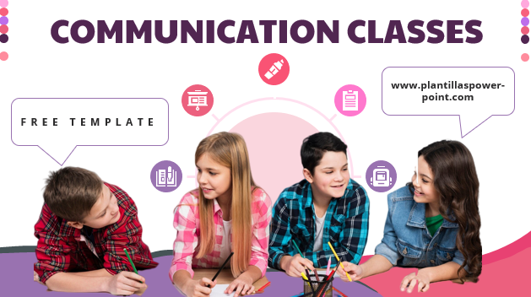
VISIT THE
NEW WEBSITE
You can replace the image on the screen with your own work. Just right-click on it and select “Replace image”

Slide 36

MOBILE WEB
You can replace the image on the screen with your own work. Just right-click on it and select “Replace image”

Slide 37
OUR TEAM
Harry Hilton
Kaliyah Smith
You can talk a bit about this person
You can talk a bit about this person

Slide 38
READING STRATEGIES
Partner reading
Making connections
Reciprocal teaching
Non-verbal imagery
Neptune is very far from the Sun
Mercury is the closest planet to the Sun
01
02
03
04
Venus is the second planet from the Sun
Jupiter is the biggest planet of them all

Slide 39
IMPORTANT PARTS OF A NOVEL
Setting
Plot
Characters
Theme
Venus is the second planet from the Sun
Mercury is the closest planet to the Sun
Neptune is the farthest planet from the Sun
Jupiter is the biggest planet of them all

Slide 40
REGIONS THAT READ MORE
Venus
Mercury
Neptune
Saturn
Venus is the second planet from the Sun
It’s the closest planet to the Sun
It’s the farthest planet from the Sun
Saturn is the ringed one and a gas giant

Slide 41
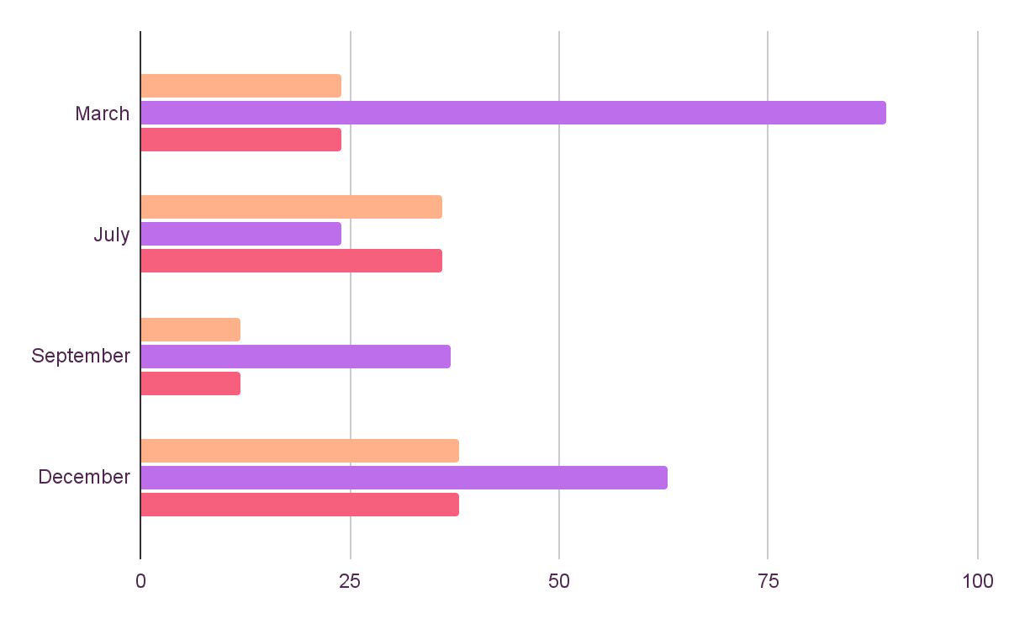
PROGRESS CLASS 21’
Vocabulary
Synthetize
Visualization
Venus is the second planet from the Sun
It’s the farthest planet from the Sun
It’s the closest planet to the Sun
Follow the link in the graph to modify its data and then paste the new one here. For more info, click here

Slide 42
THANKS!
Does anyone have questions?

Slide 43
ALTERNATIVE RESOURCES
Here’s an assortment of alternative resources whose style fits that of this template

Slide 44
www.plantillaspower-point.com

Slide 45
RESOURCES

Slide 46
RESOURCES

Slide 47
RESOURCES

Slide 48
...and our sets of editable icons

Slide 49
Educational Icons
Medical Icons

Slide 50
Business Icons
Teamwork Icons

